Slide 1

Searching Techniques
Artificial Intelligence
Avinash Shrivas

Slide 2
Contents
Searching Techniques:
- Uninformed Search Methods
Breadth First Search (BFS)
Depth First Search (DFS)
- Informed Search Methods
Hill climbing search
Best First Search
A* Search
- Heuristic Function

Slide 3
Uninformed Search Algorithms
Uninformed search is a class of general-purpose search algorithms which operates in brute force-way.
It do not have additional information about state or search space other than how to traverse the tree, so it is also called blind search. (no idea about goal)
Types of Uninformed search algorithms:
Breadth-first Search
Depth-first Search
Depth-limited Search
Iterative deepening depth-first search
Uniform cost search
Bidirectional Search

Slide 4
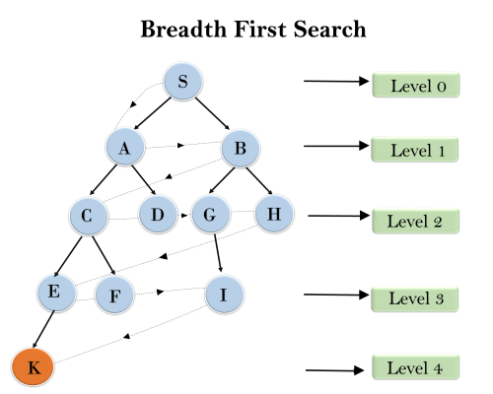
1. Breadth-first Search
In the below tree structure, the traversing of the tree using BFS algorithm from the root node S to goal node K is shown.
S---> A--->B---->C--->D---->G--->H--->E---->F---->I---->K

Slide 5
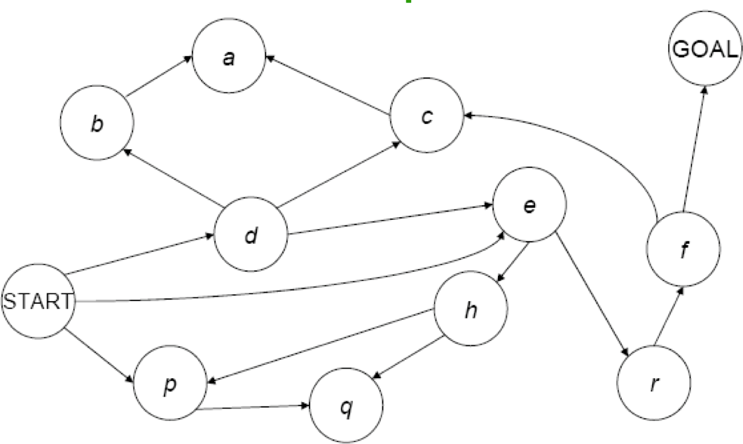
Breadth First Search
Place Start in the Frontier.
Expand all nodes reachable from Start in 1 step, but not more than 1; add path to back of Frontier list.
Expand all nodes reachable from Start in 2 step, but not more than 2; add path to back of Frontier list.
Expand all nodes reachable from Start in 3 step, but not more than 3; add to path back of Frontier list.
And so on ….
5

Slide 6
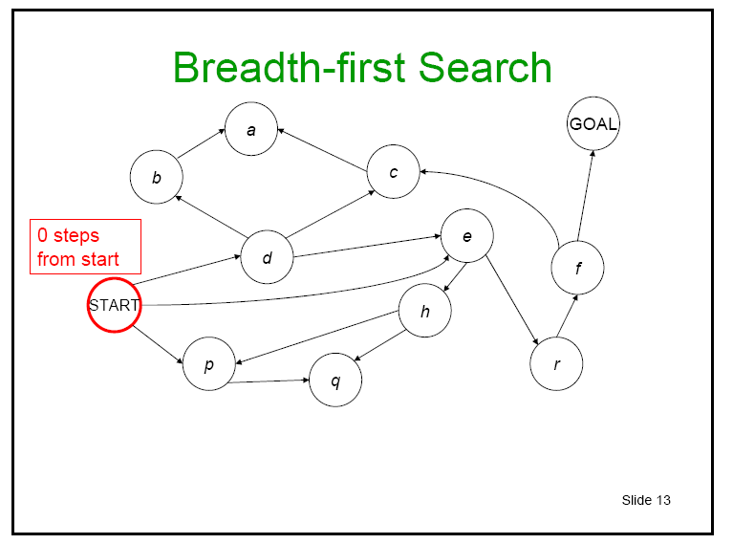
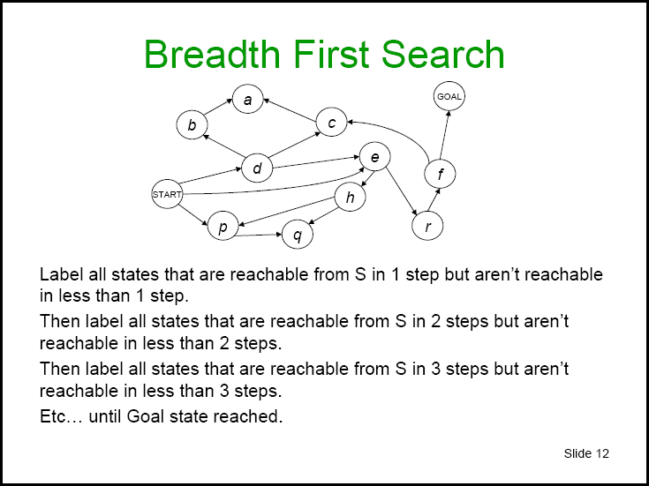
6

Slide 7
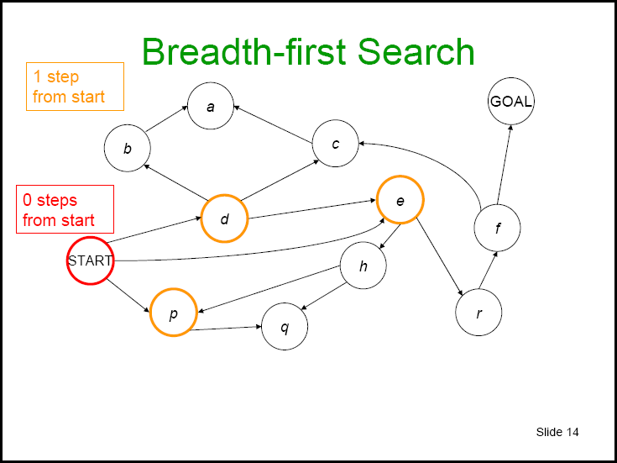
7

Slide 8
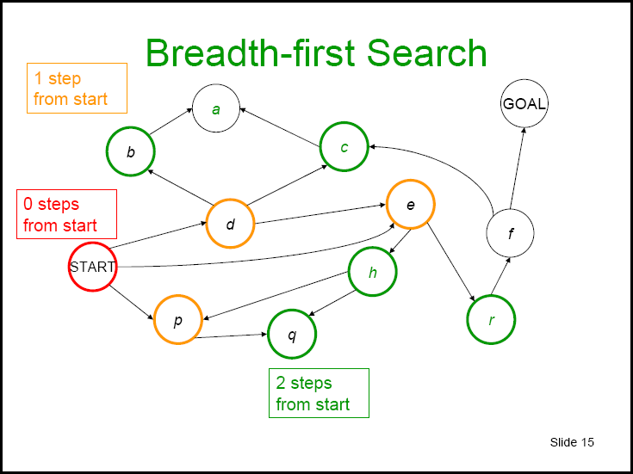
8

Slide 9
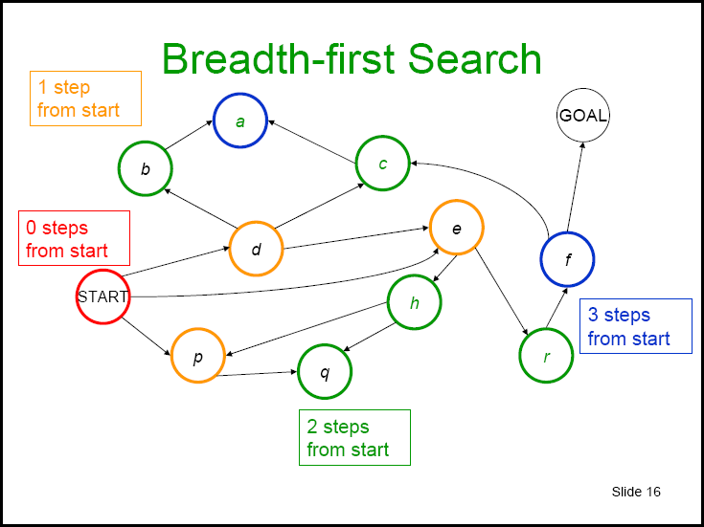
9

Slide 10
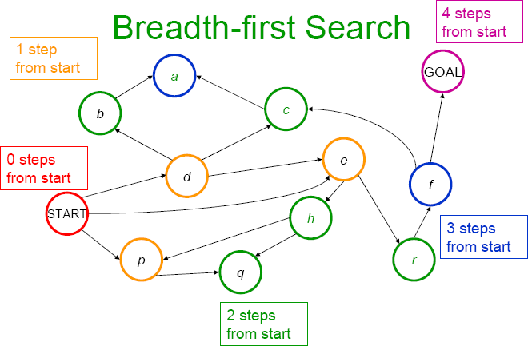
10

Slide 11
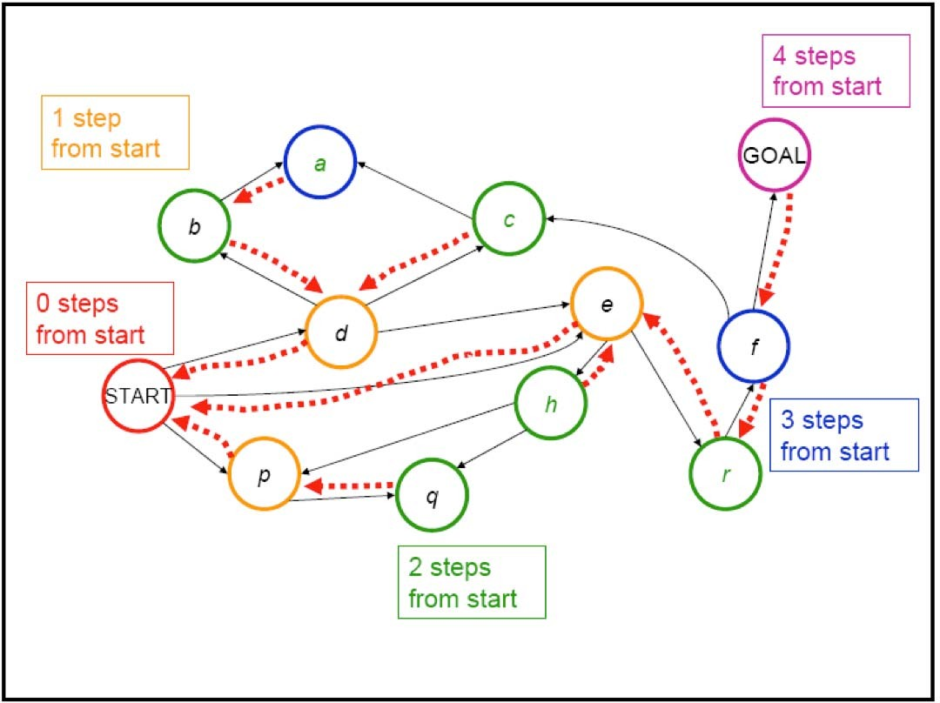
Solved!!
Note that nodes (or states) on the frontier include references to parents in this example.
11

Slide 12
1. Breadth-first Search
Breadth-first search is the most common search strategy for traversing a tree or graph.
BFS algorithm starts searching from the root node of the tree and expands all successor node at the current level before moving to nodes of next level.
Breadth-first search implemented using FIFO queue data structure.
Advantages:
BFS will provide a solution if any solution exists.
If there are more than one solution for a given problem, then BFS will provide the minimal solution which requires the least number of steps.
Disadvantages:
It requires lots of memory since each level of the tree must be saved into memory to expand the next level.
BFS needs lots of time if the solution is far away from the root node.

Slide 13
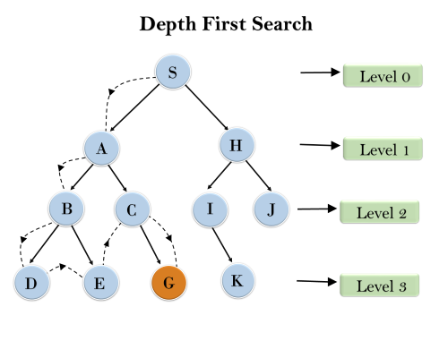
2. Depth-first Search
In the below search tree, we have shown the flow of depth-first search, and it will follow the order as:
Root node → Left node → right node

Slide 14
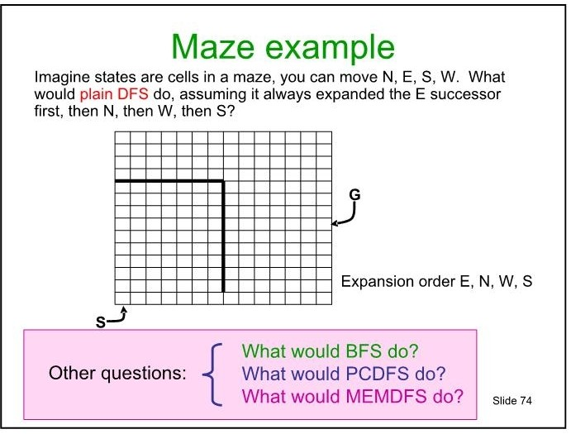
N
W
E
S
start What would BFS do?

Slide 15
2. Depth-first Search
Depth-first search is a recursive algorithm for traversing a tree or graph data structure.
It is called the depth-first search because it starts from the root node and follows each path to its greatest depth node before moving to the next path.
DFS uses a stack (LIFO) data structure for its implementation.
Advantage:
DFS requires very less memory
It takes less time to reach to the goal node
Disadvantage:
There is no guarantee of finding the solution.
DFS algorithm goes for deep down searching and may go to the infinite loop.

Slide 16
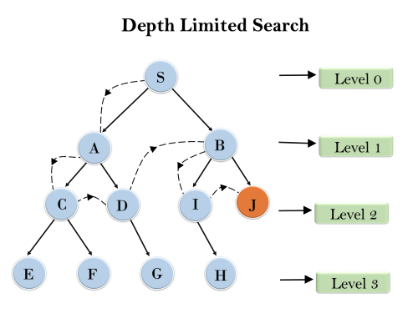
3. Depth-Limited Search
The DLS is the implementation of DFS for the given tree only up to predetermined depth limit.
The original depth of the tree is 3, we can set the limit to the depth for this example it is set as l = 2.
The DFS can be preformed considering the depth of tree as 2

Slide 17
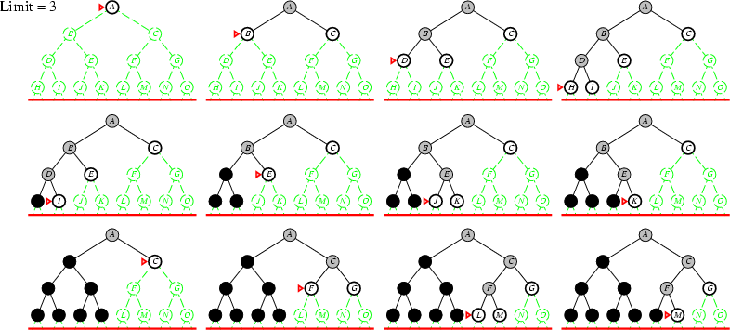
Depth Limited Search Example

Slide 18
3. Depth-Limited Search
A depth-limited search algorithm is similar to depth-first search with a predetermined limit.
Depth-limited search can be terminated with two Conditions of failure:
Standard failure value: It indicates that problem does not have any solution.
Cutoff failure value: It defines no solution for the problem within a given depth limit.
Advantages:
Depth-limited search is Memory efficient.
Disadvantages:
Depth-limited search also has a disadvantage of incompleteness.
It may not be optimal if the problem has more than one solution.

Slide 19
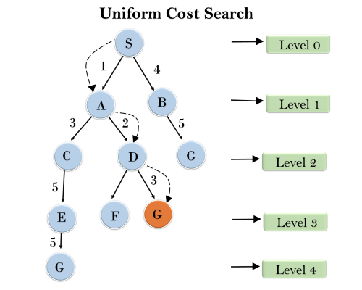
4. Uniform-cost Search Algorithm:
 | S = Initial State and G = Goal State, Start with S
Step1 | SA = 1 and SB = 4, so choose SA and explore A
Step2 | SAC = 4 and SAD = 3, so choose SAD and explore D
Step3 | SADF = 7 and SADG = 6, so choose SADG and Explore G, which is a Goal.
Step4 | Terminates the search and returns Solution Path SADG with cost = 6
Note | Three possible Solutions: SBG with cost = 9 SACEG with cost = 14 SADG with cost = 6

Slide 20
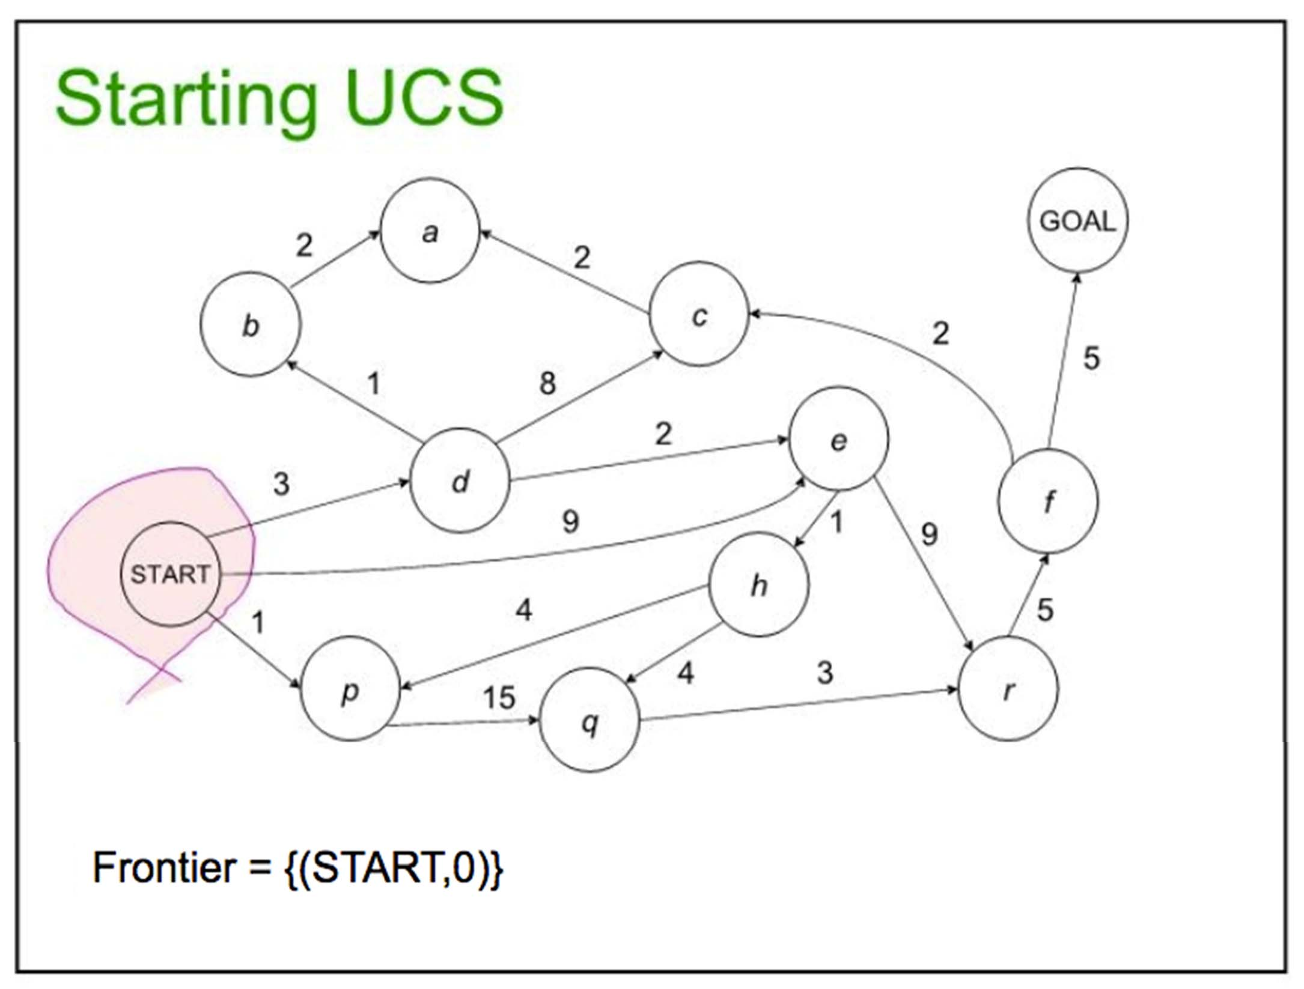
20

Slide 21
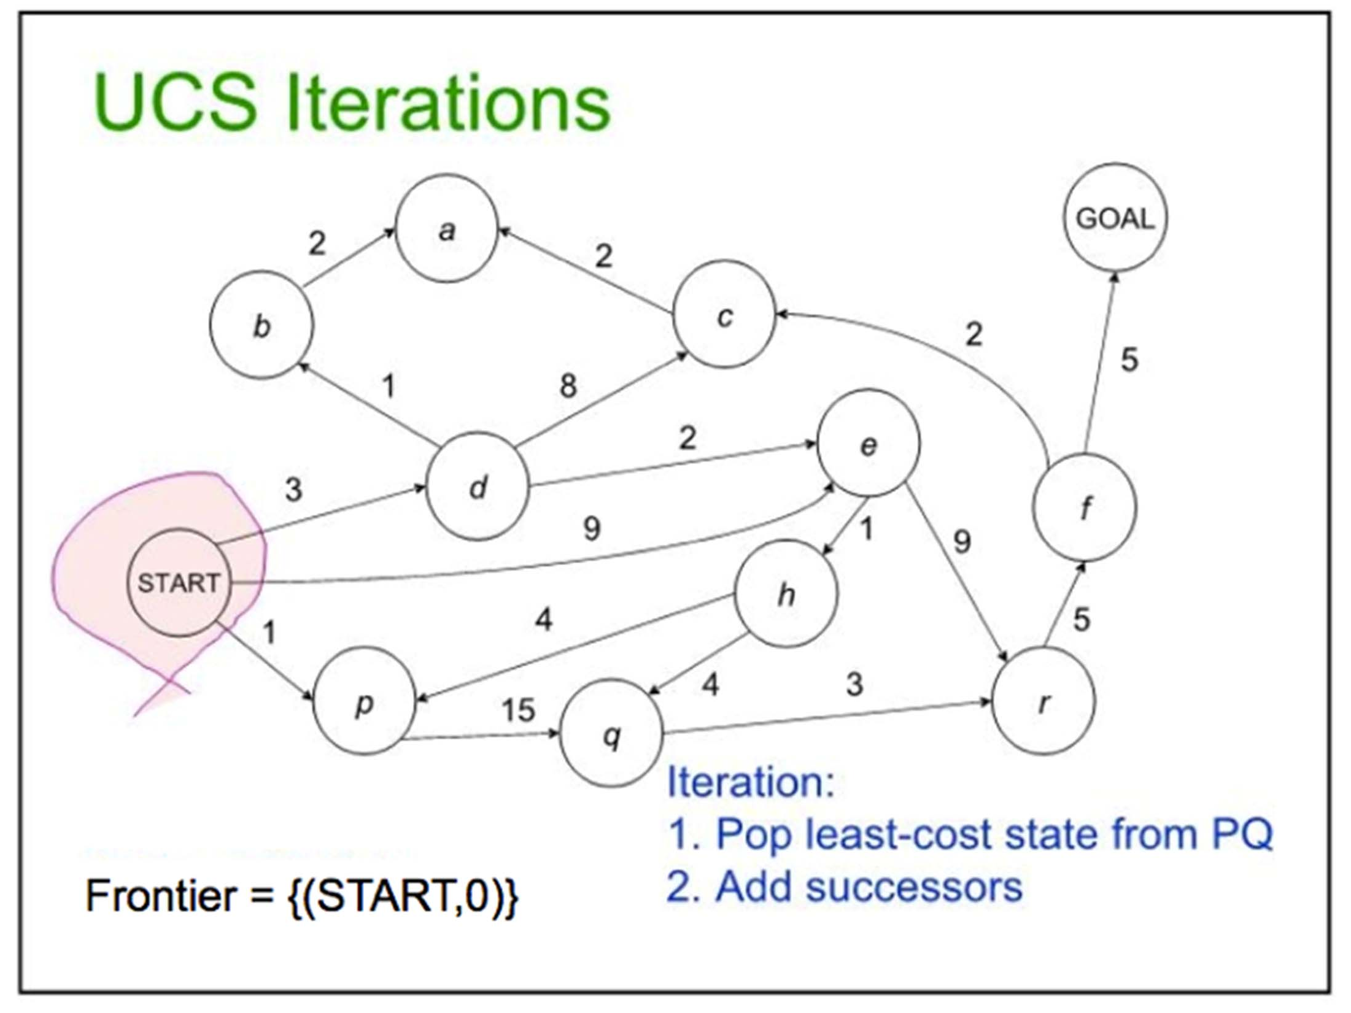
21

Slide 22
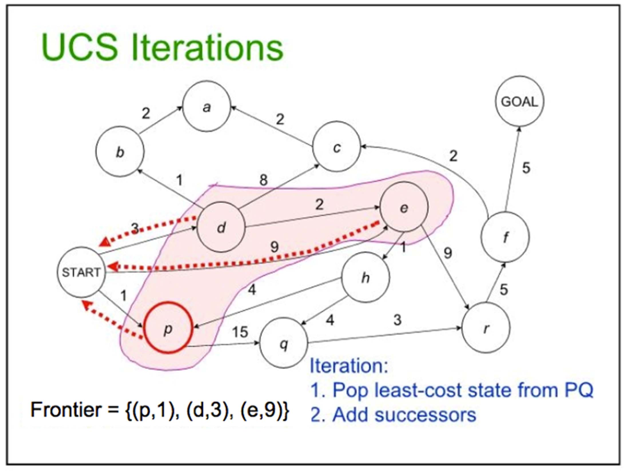
22

Slide 23
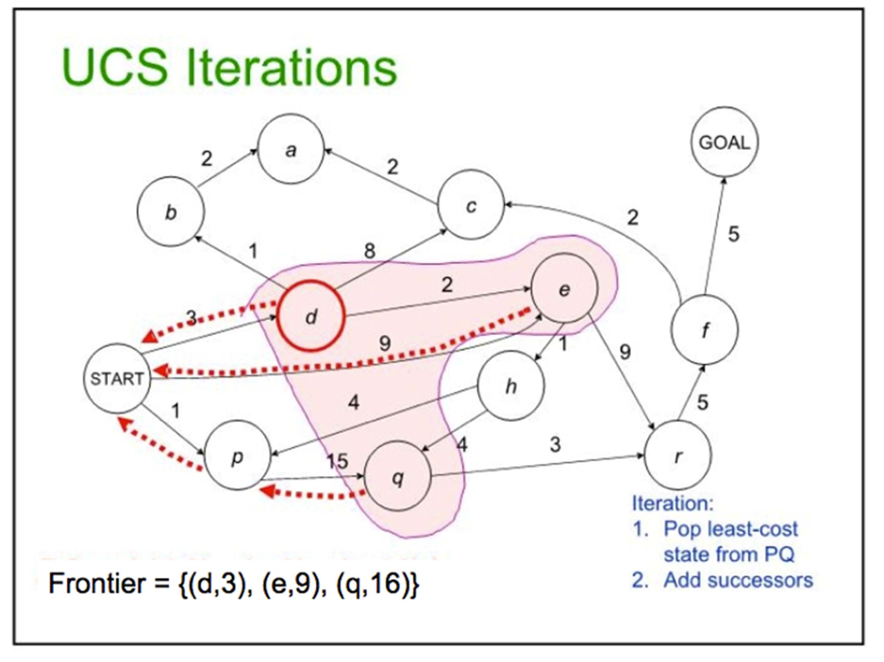
23

Slide 24
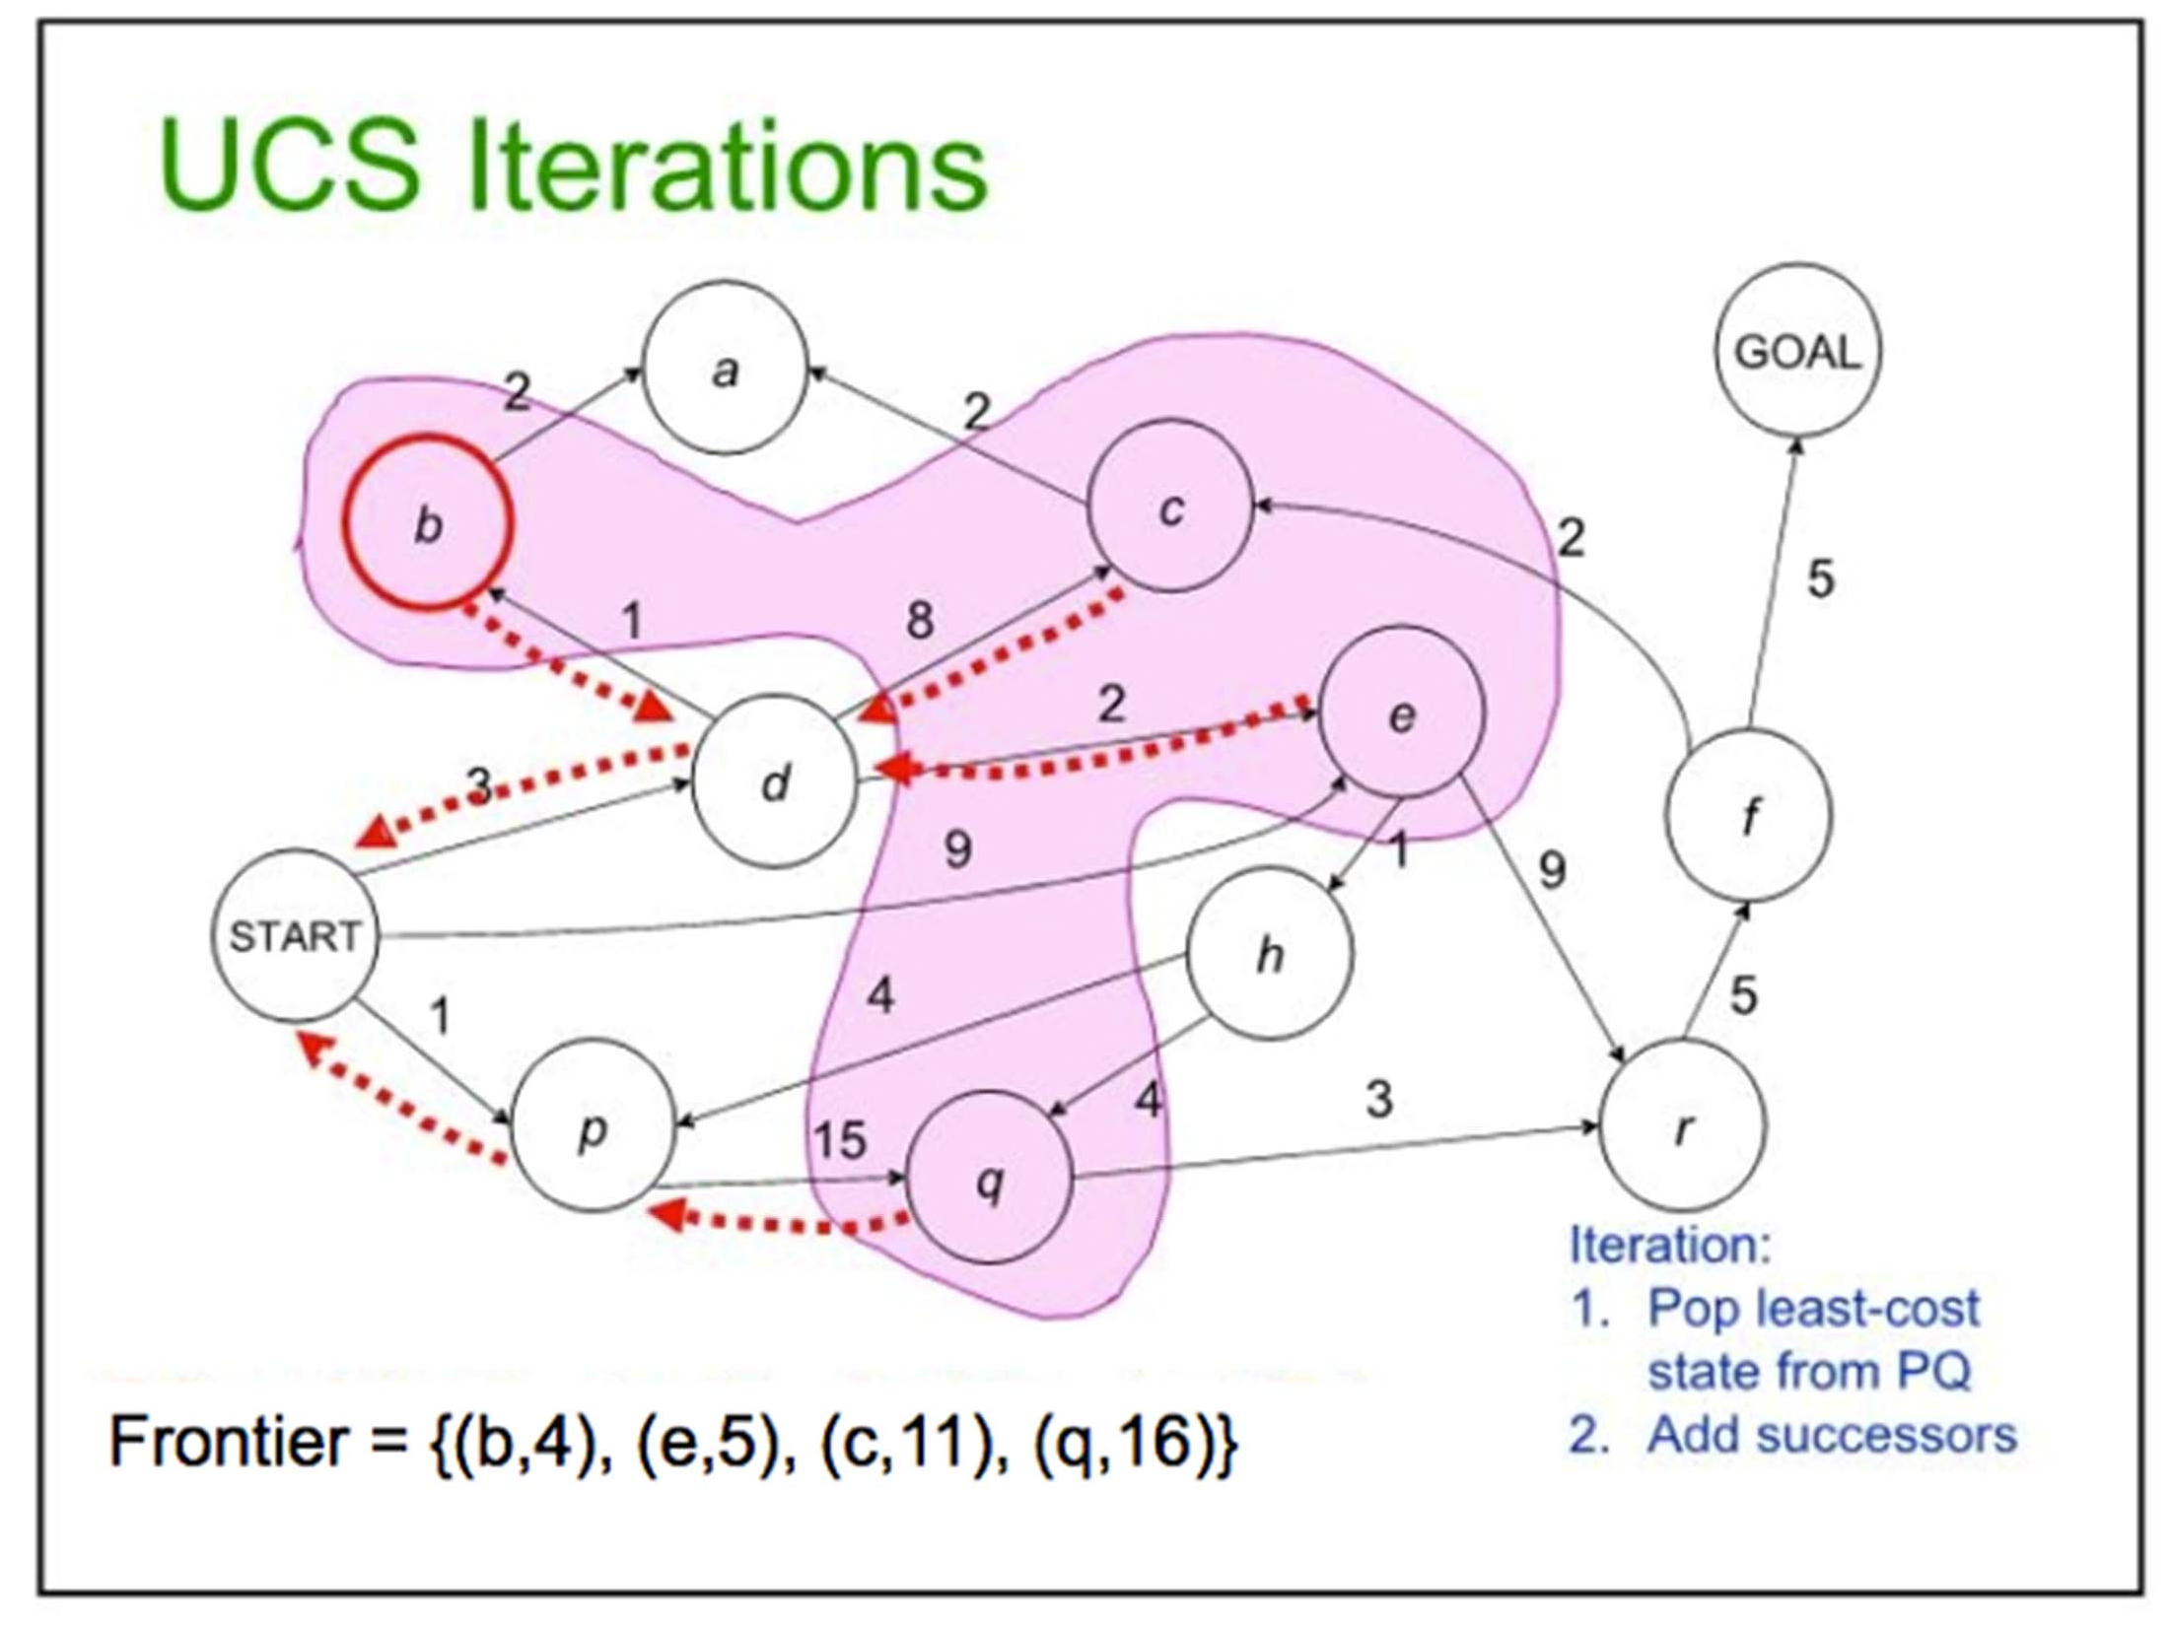
24

Slide 25
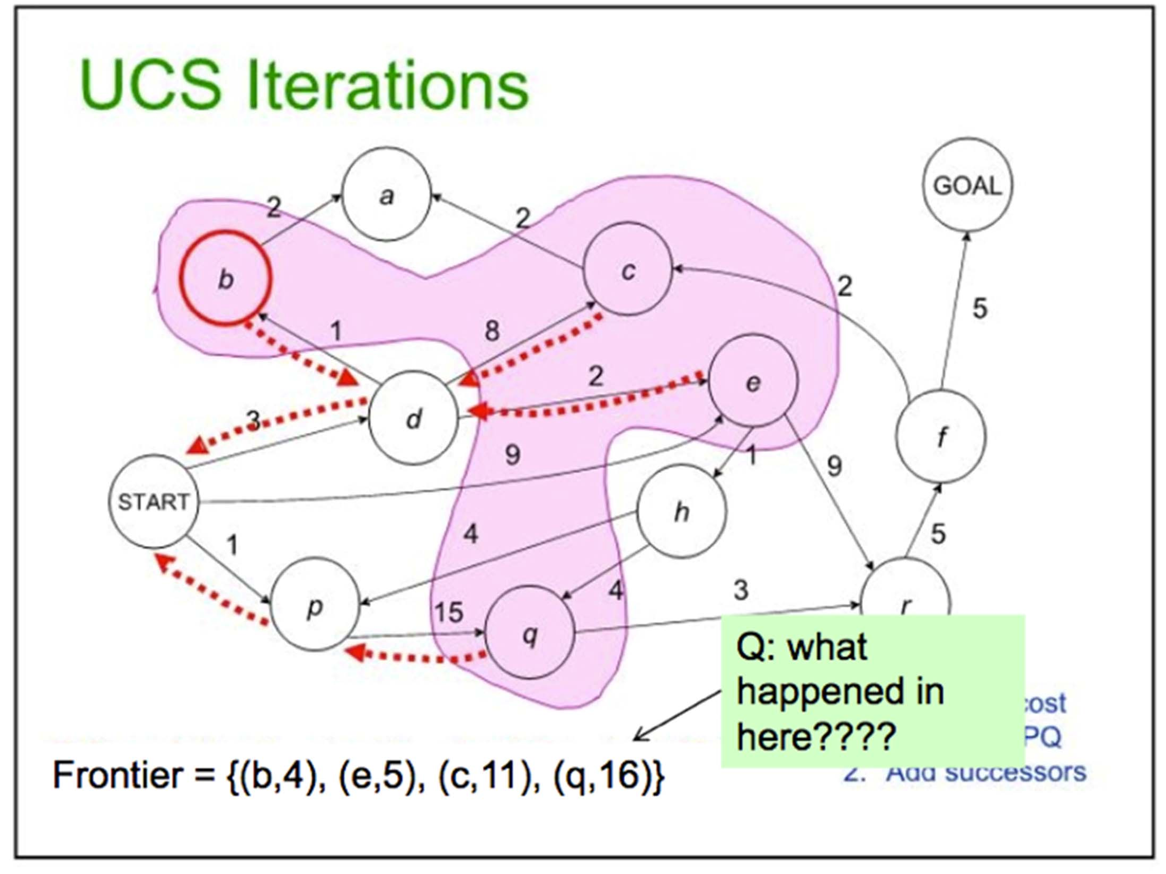
25

Slide 26
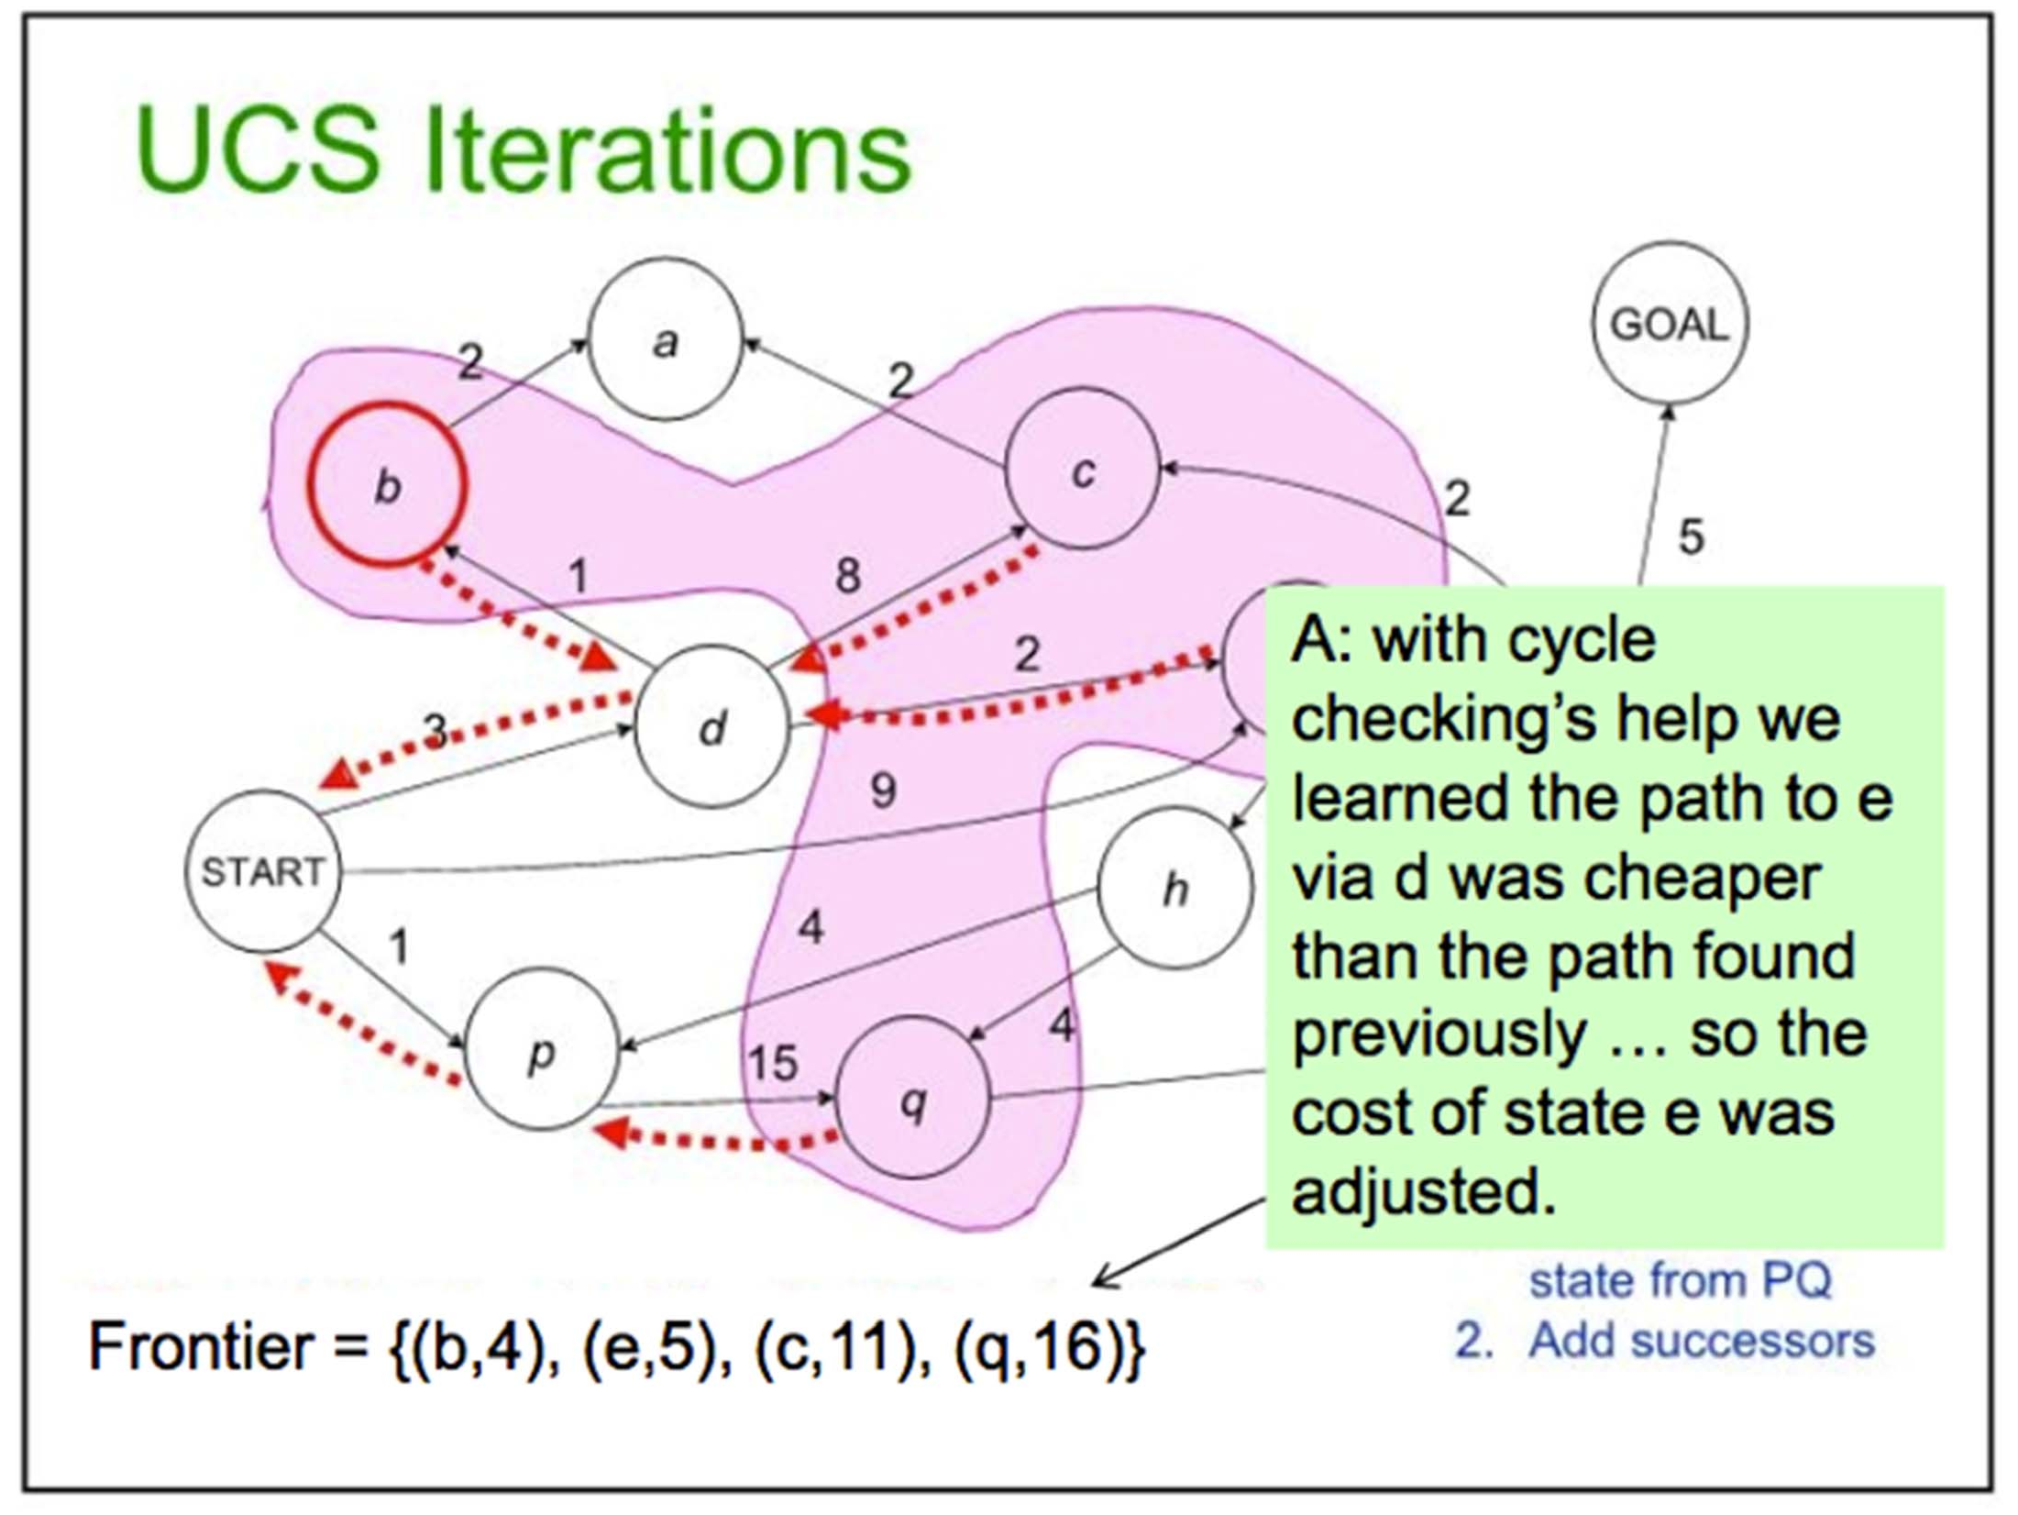
26

Slide 27
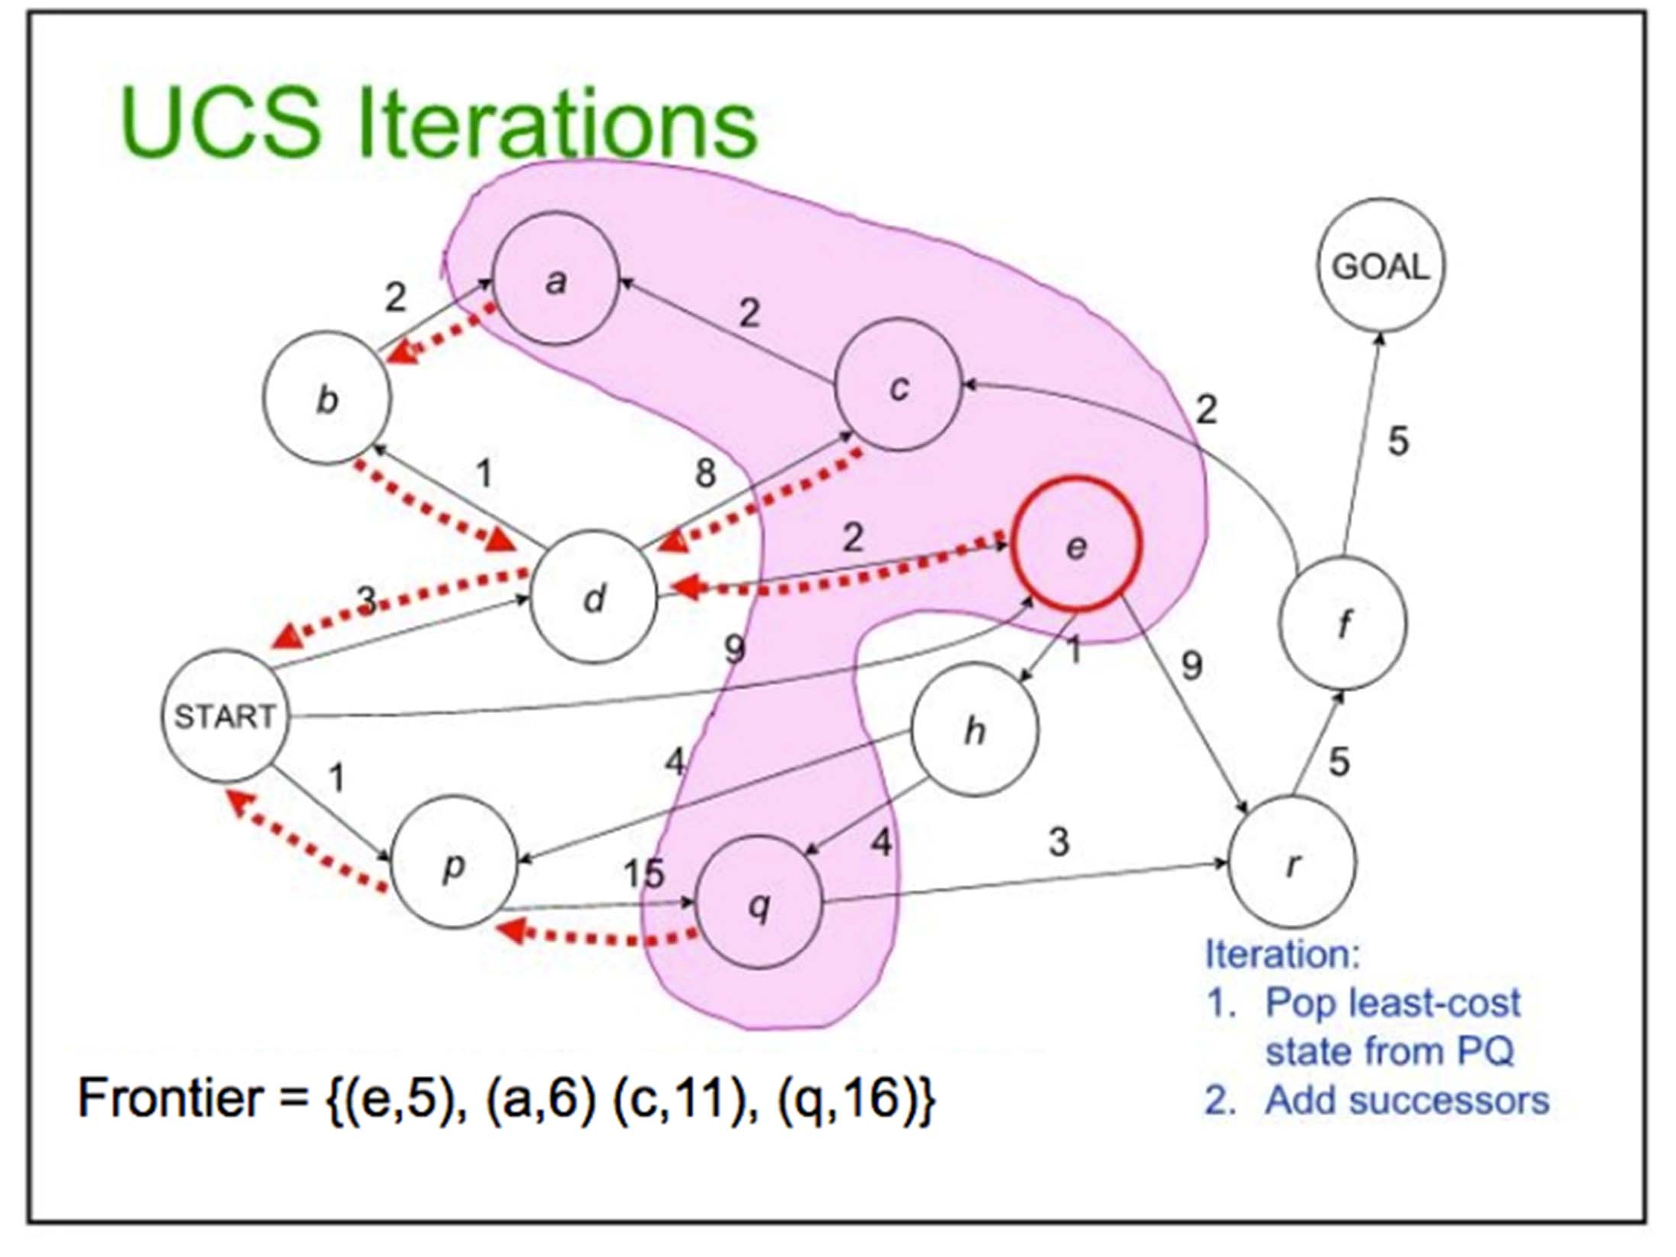
27

Slide 28
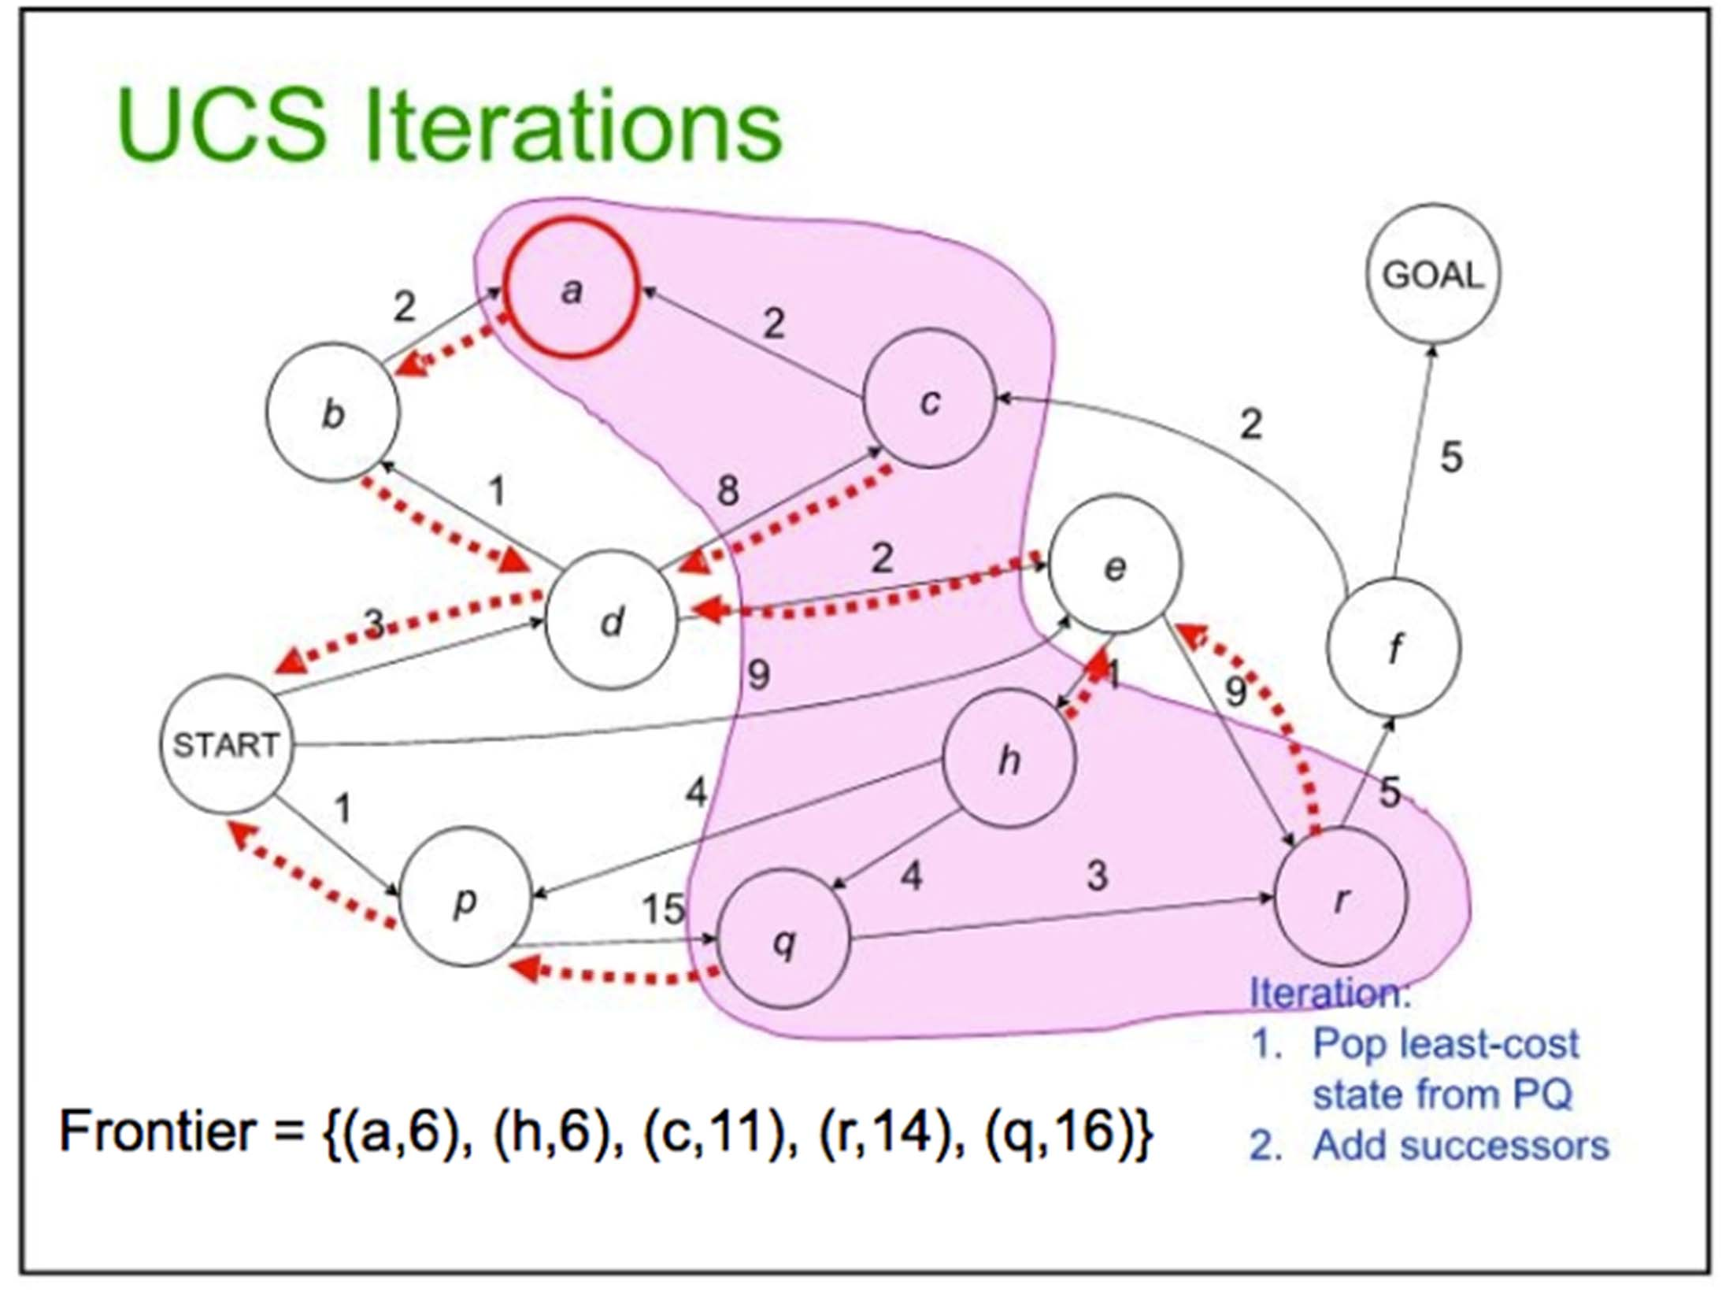
28

Slide 29
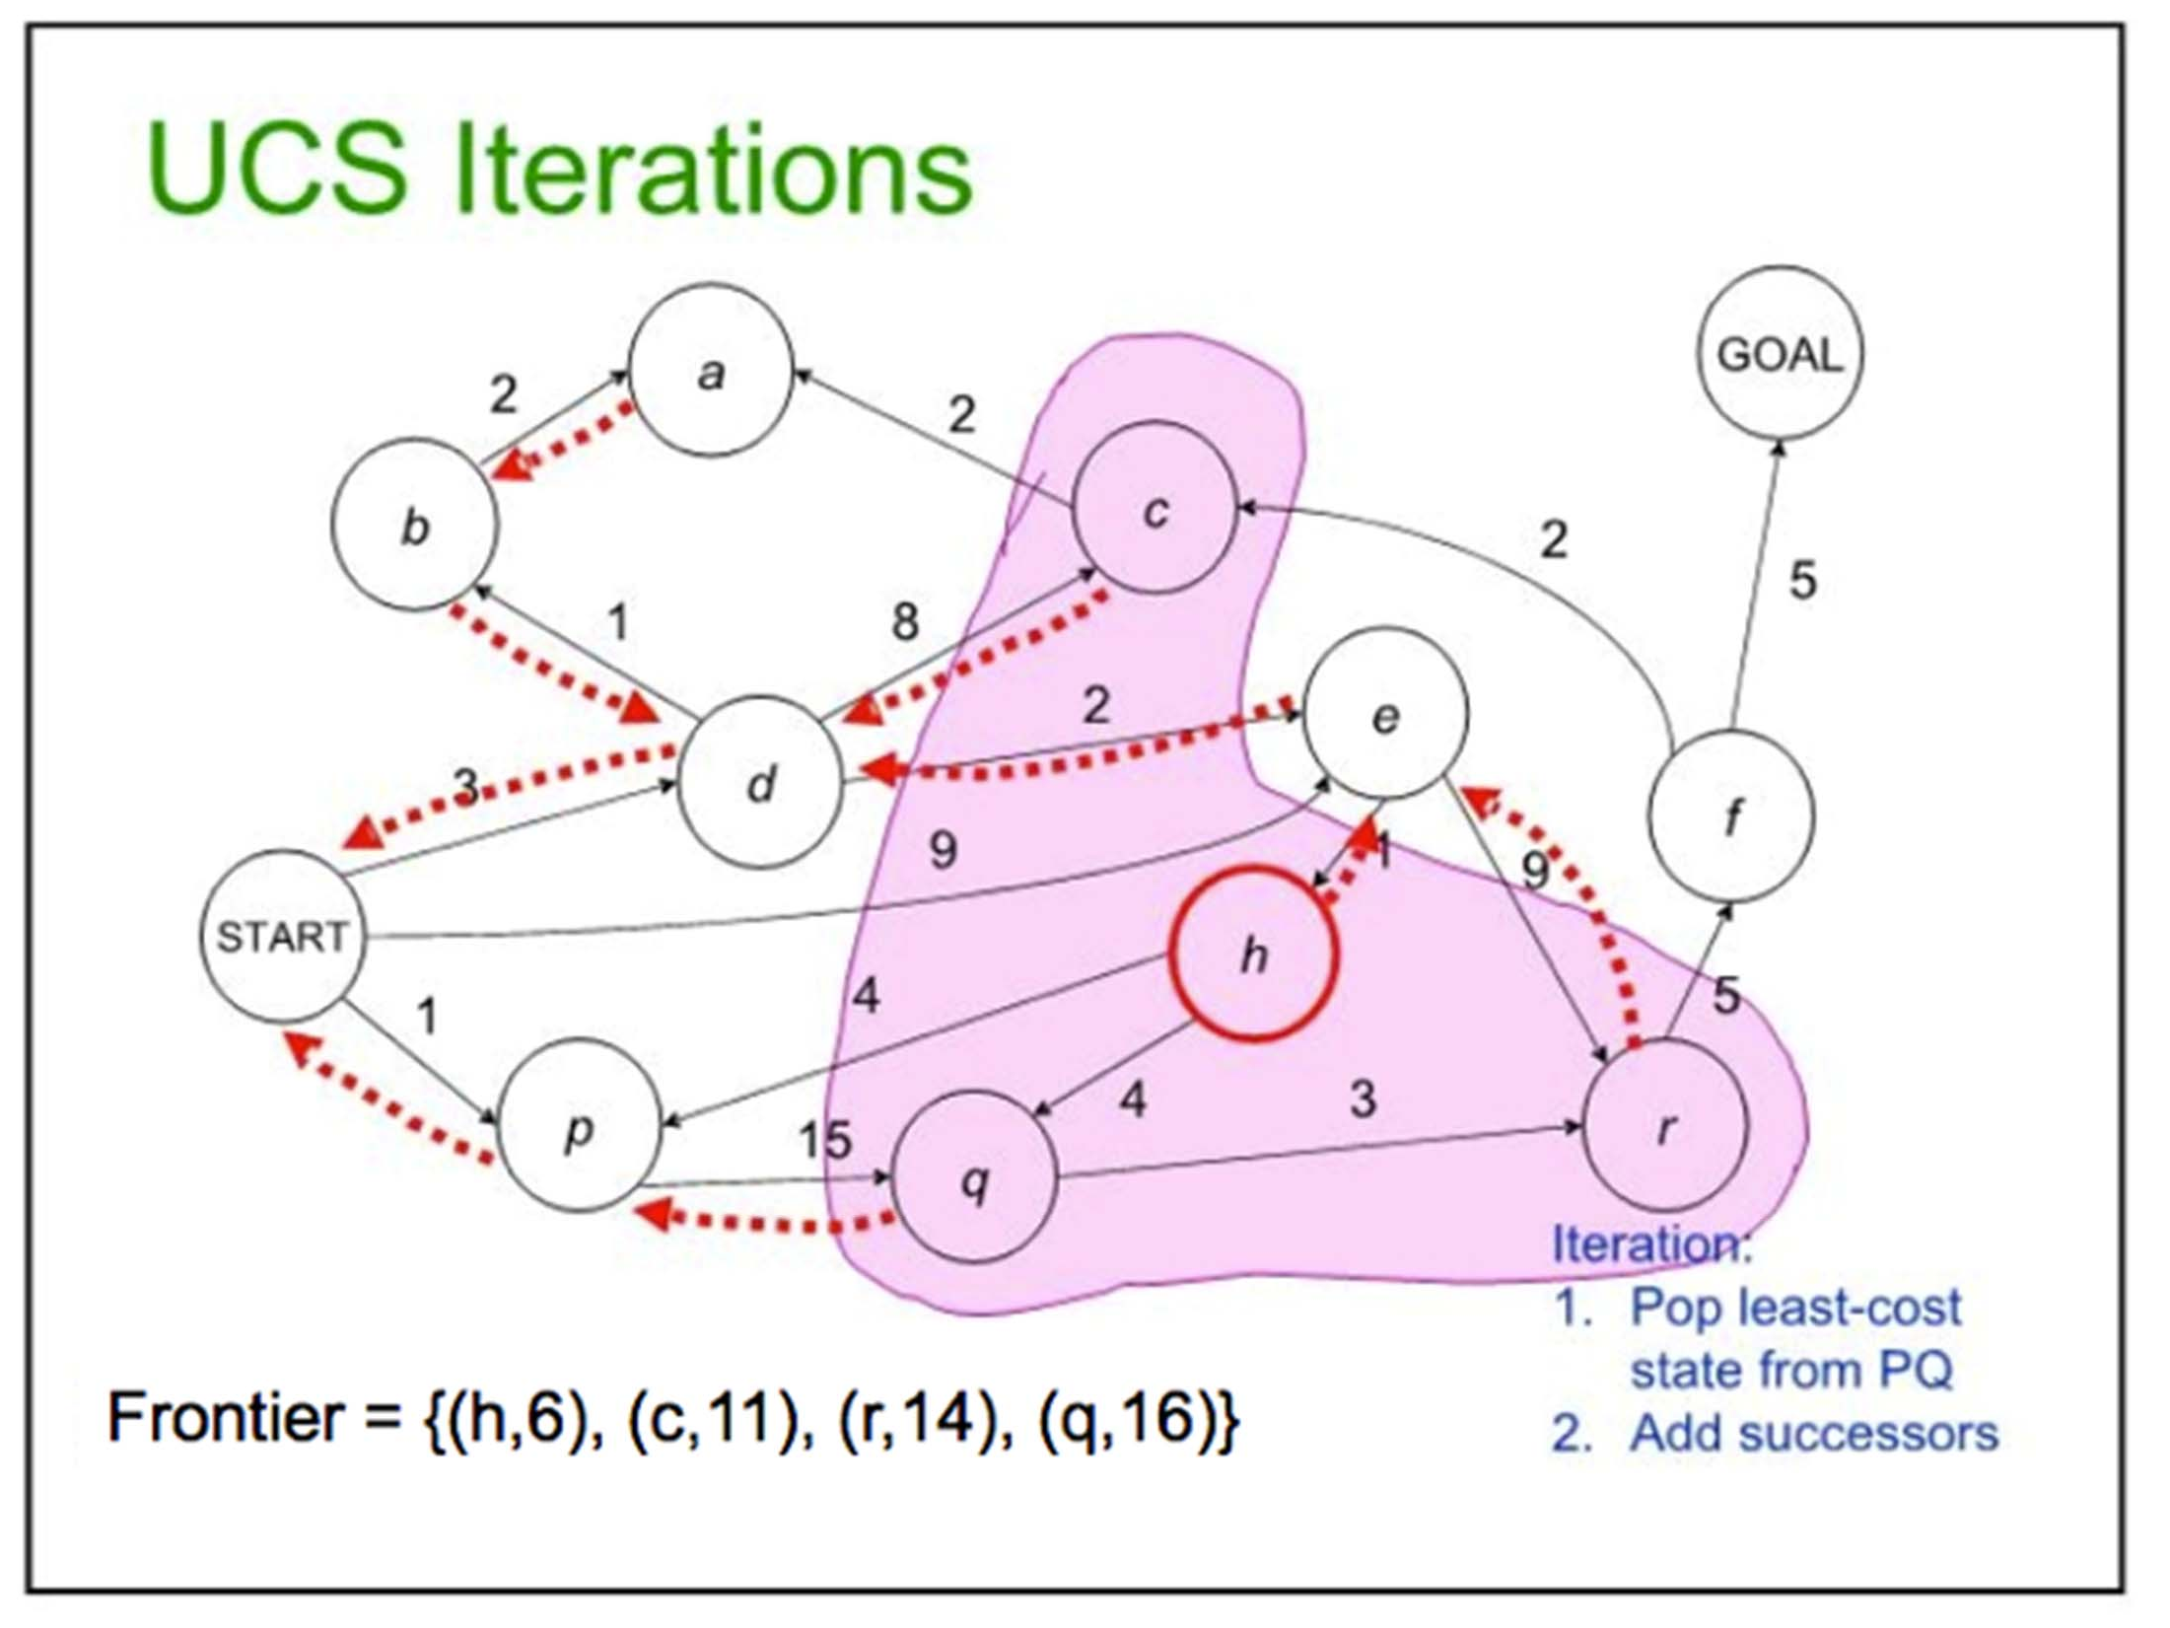
29

Slide 30
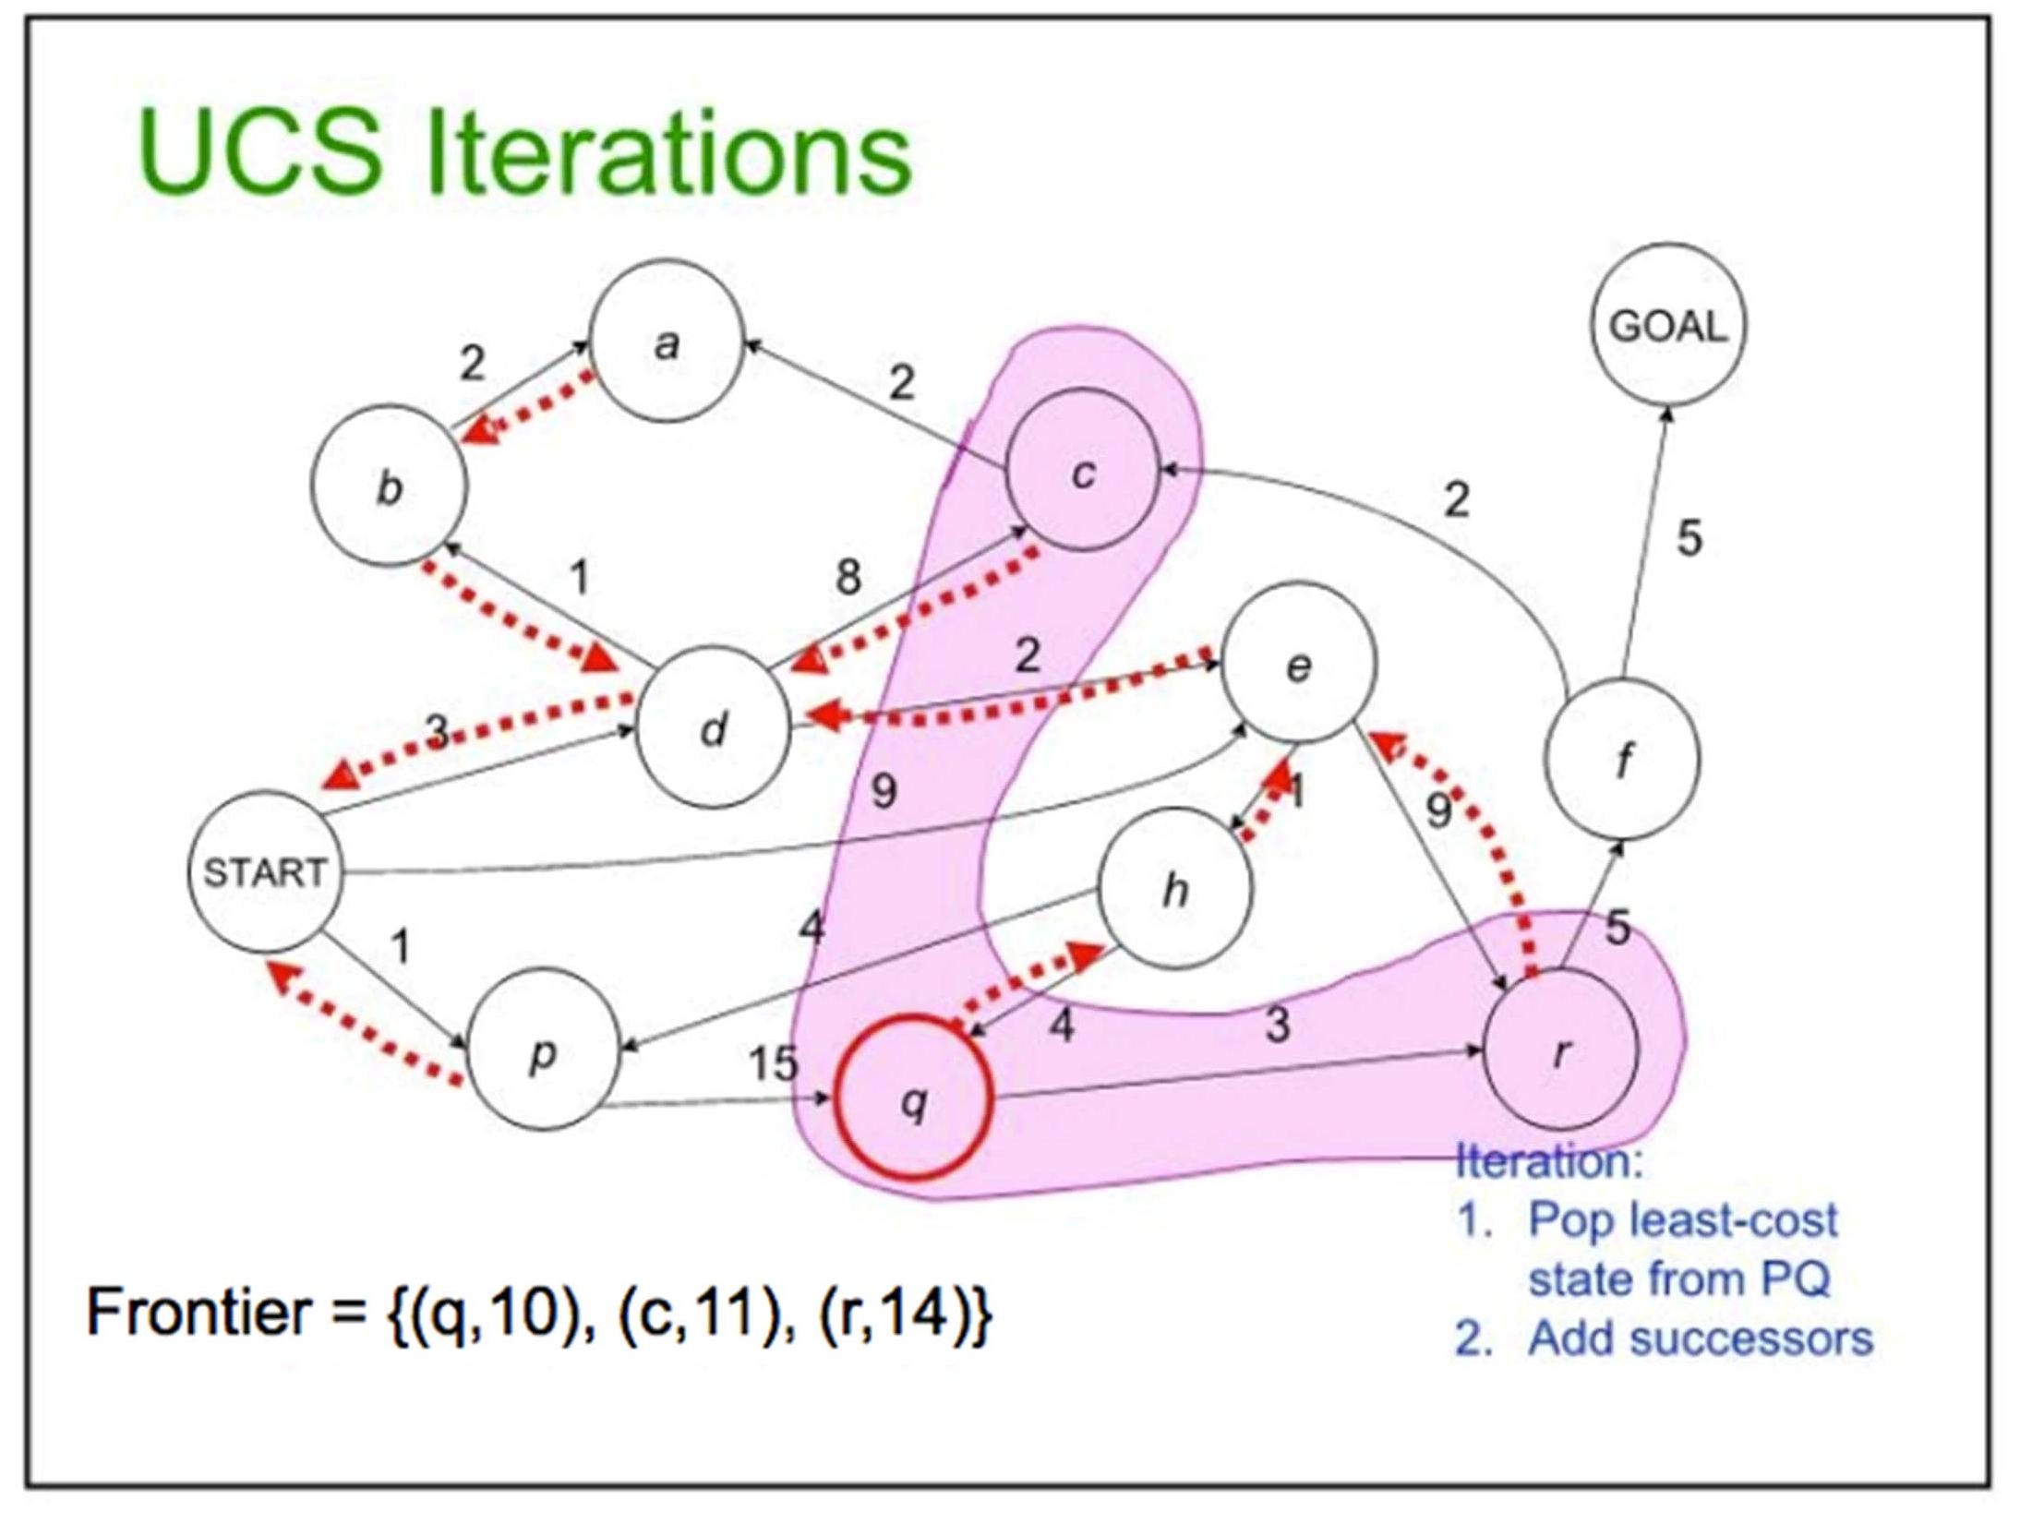
30

Slide 31
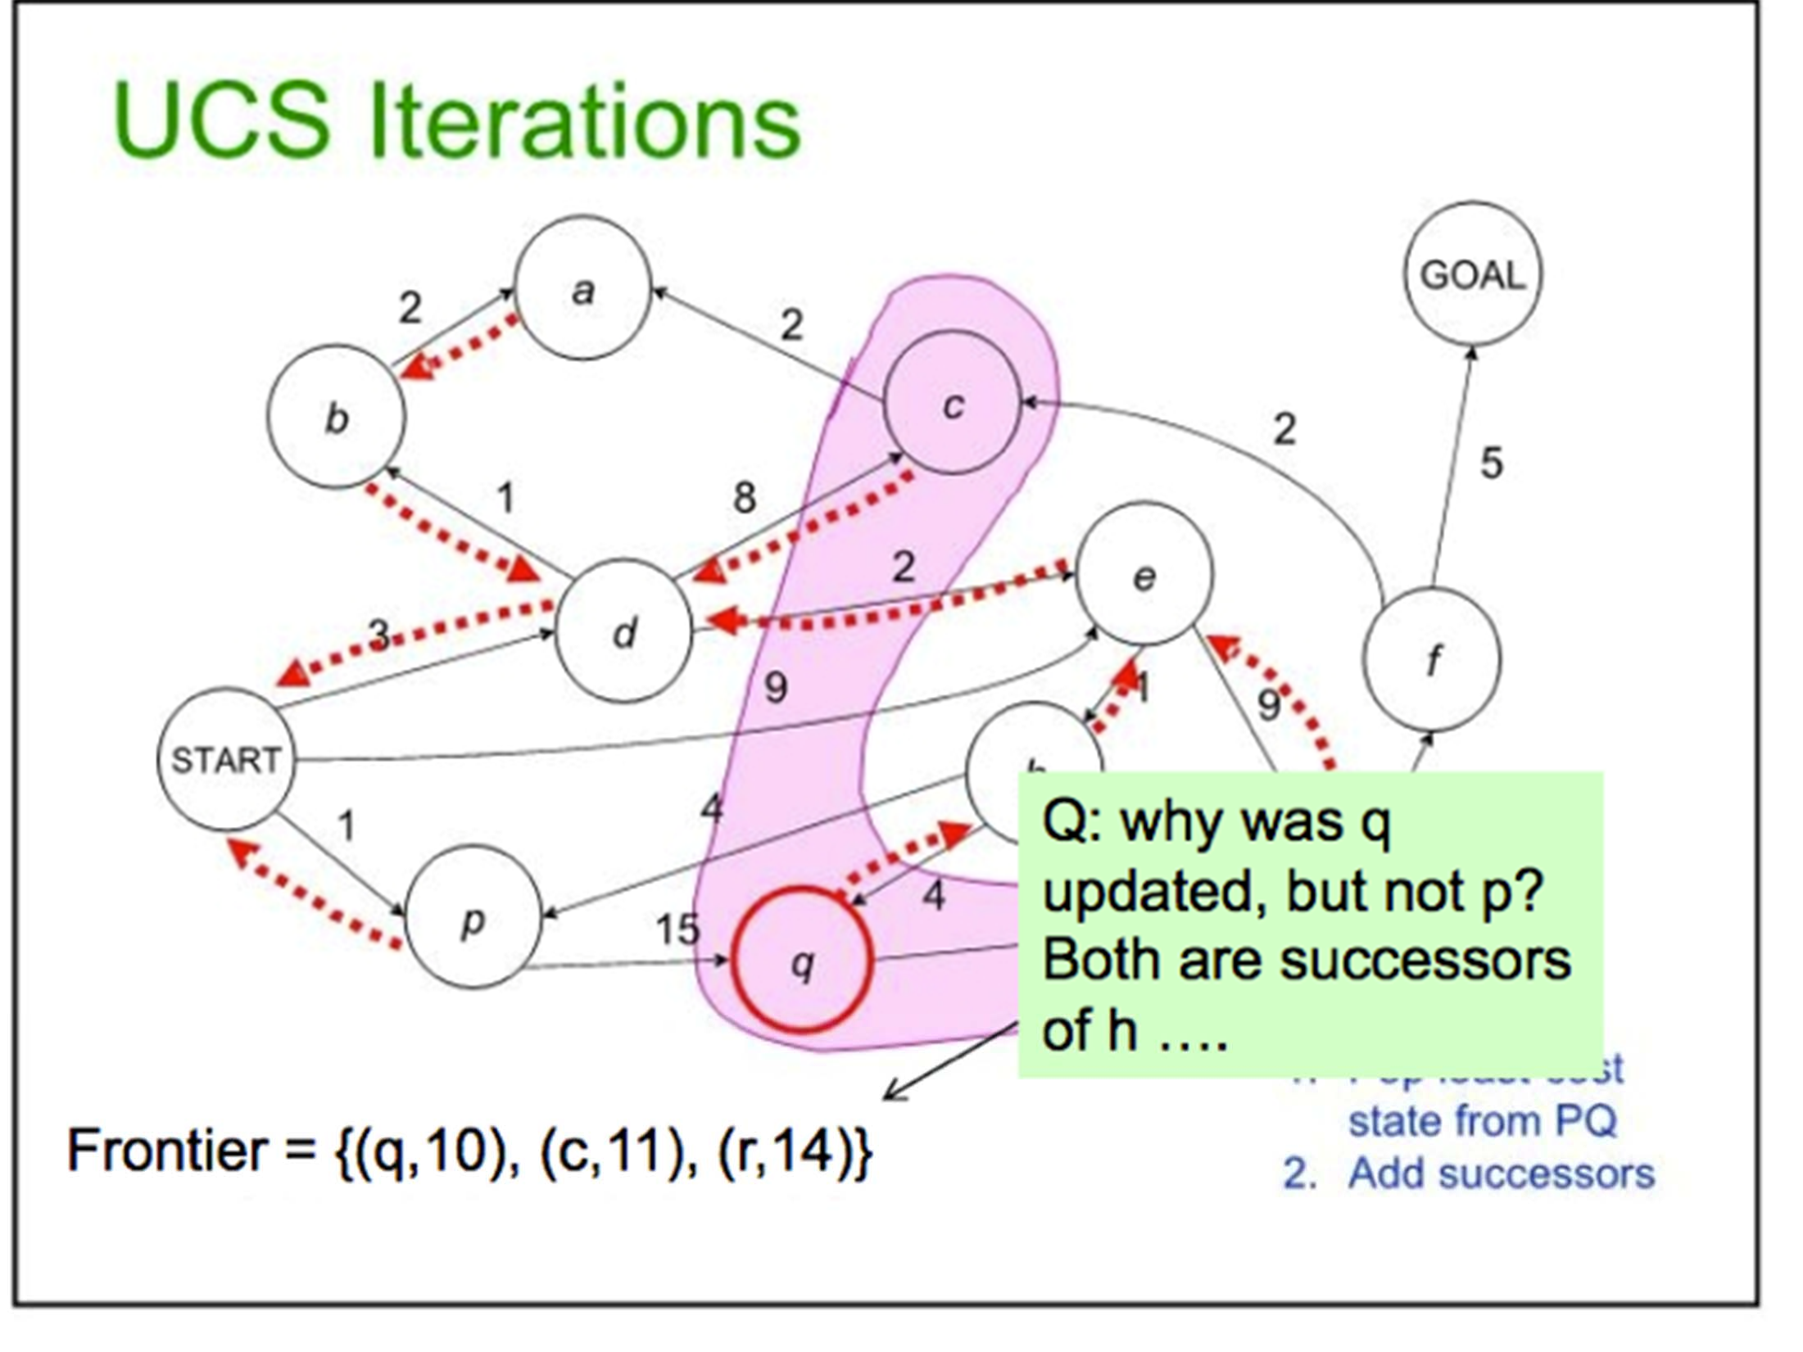
31

Slide 32
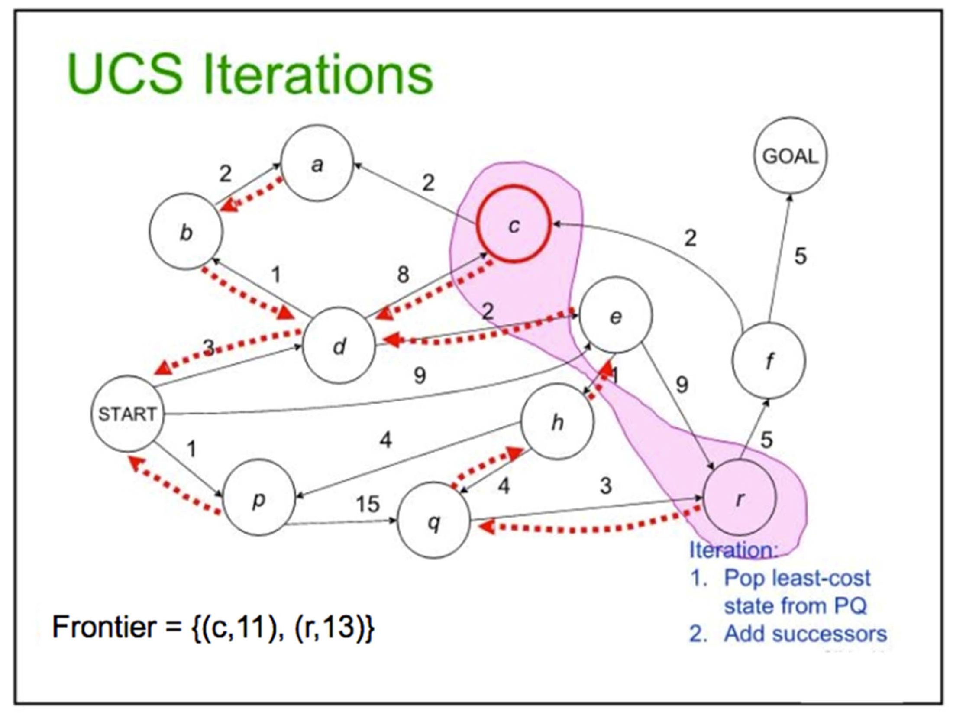
32

Slide 33
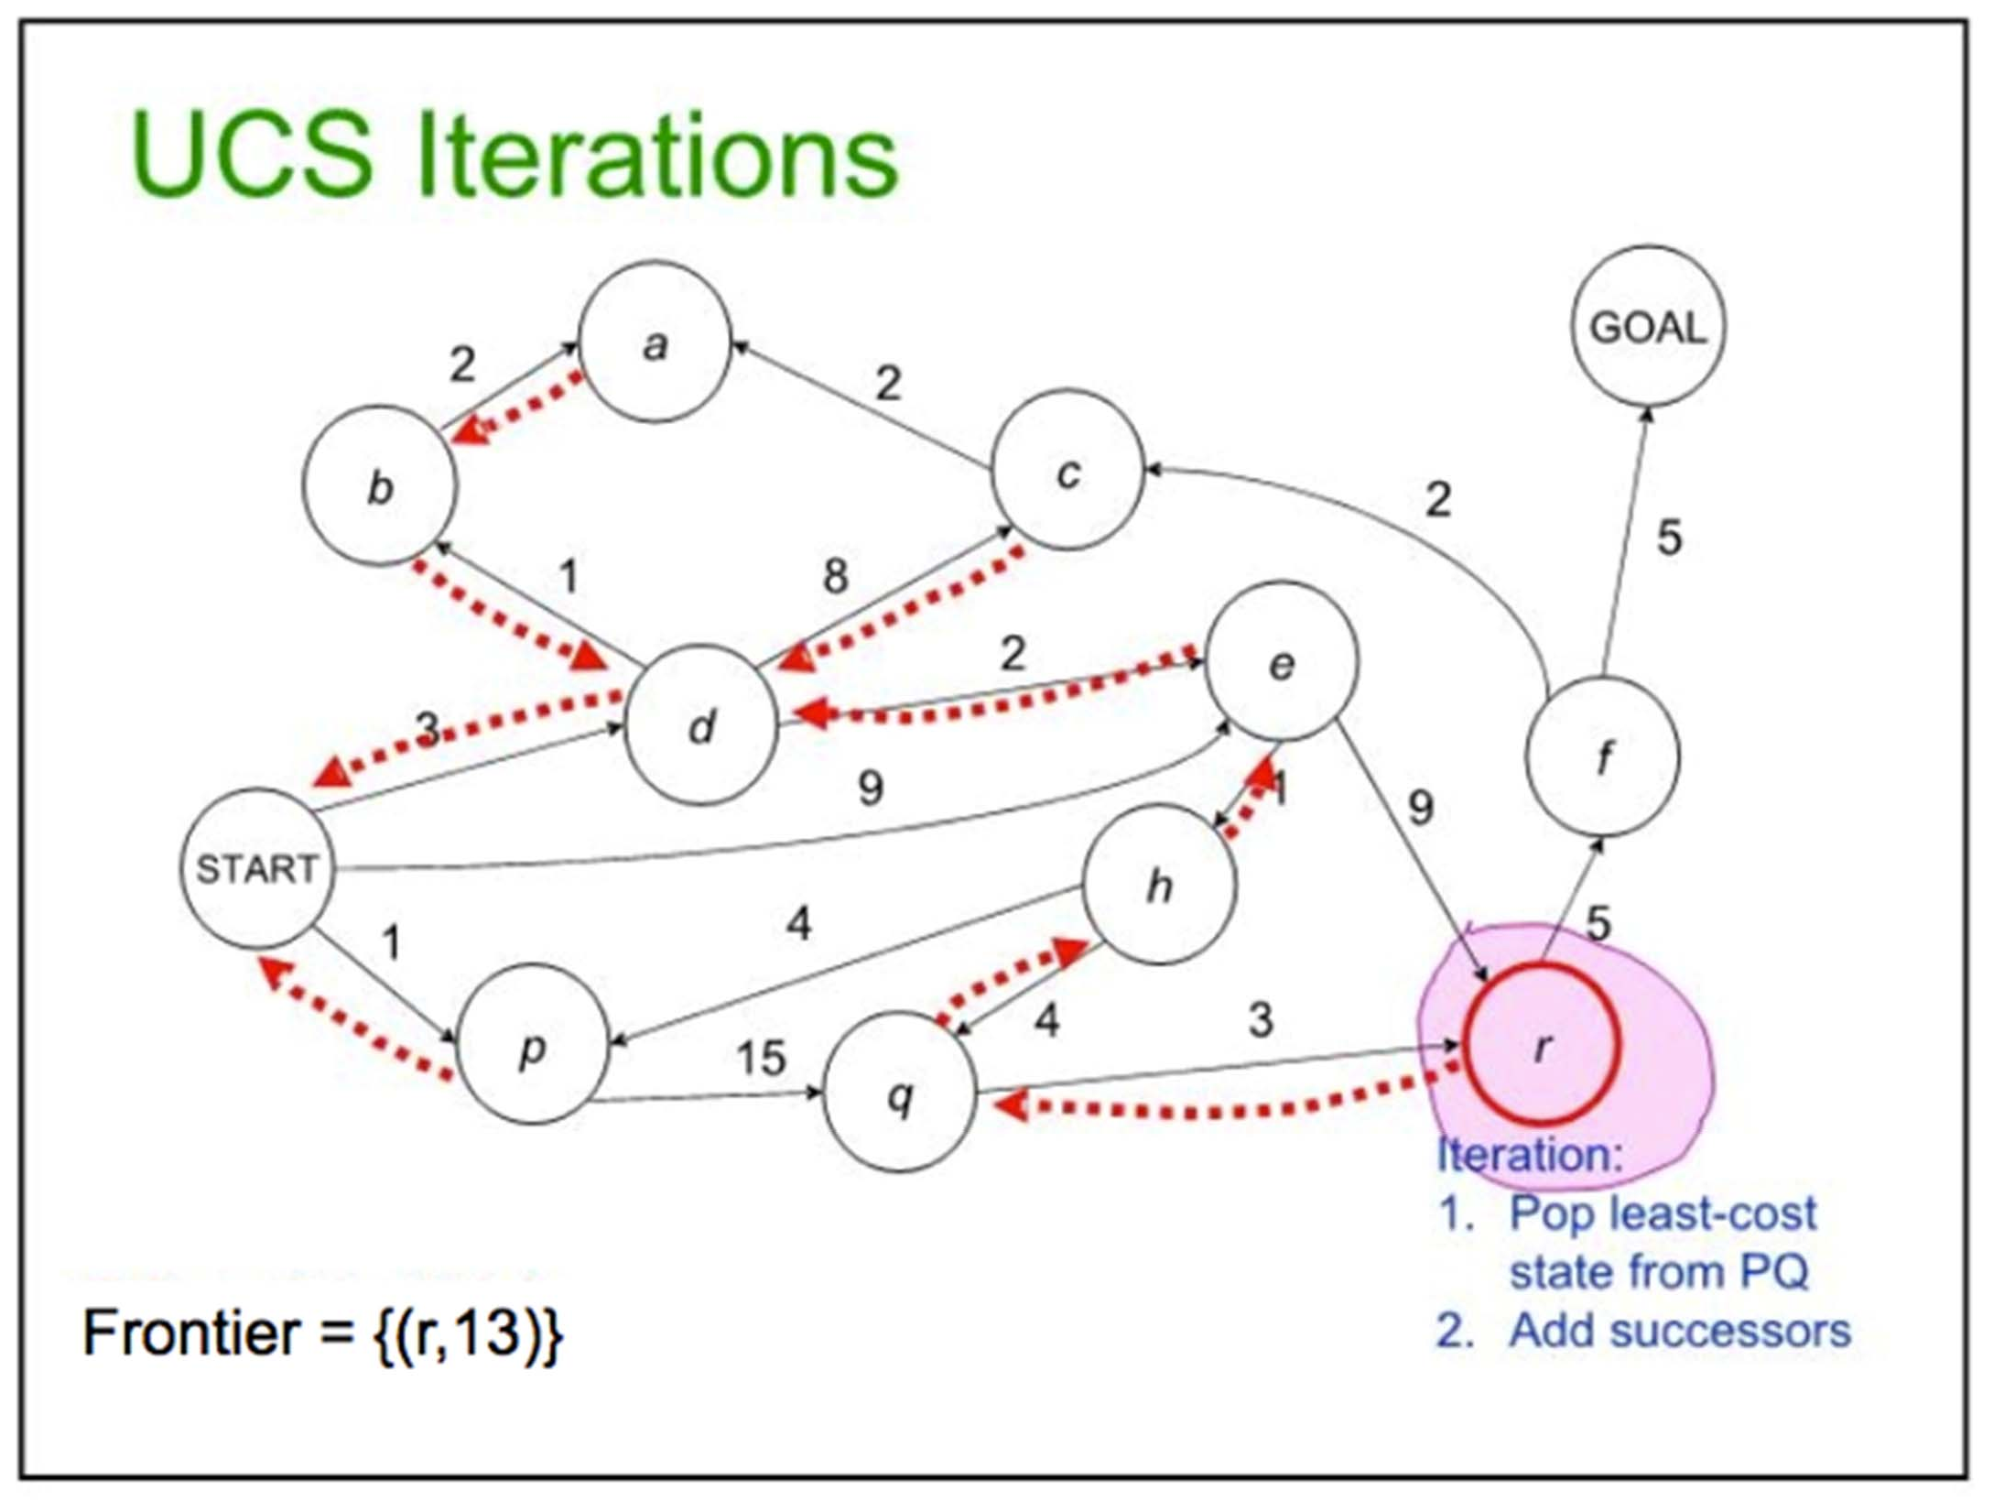
33

Slide 34
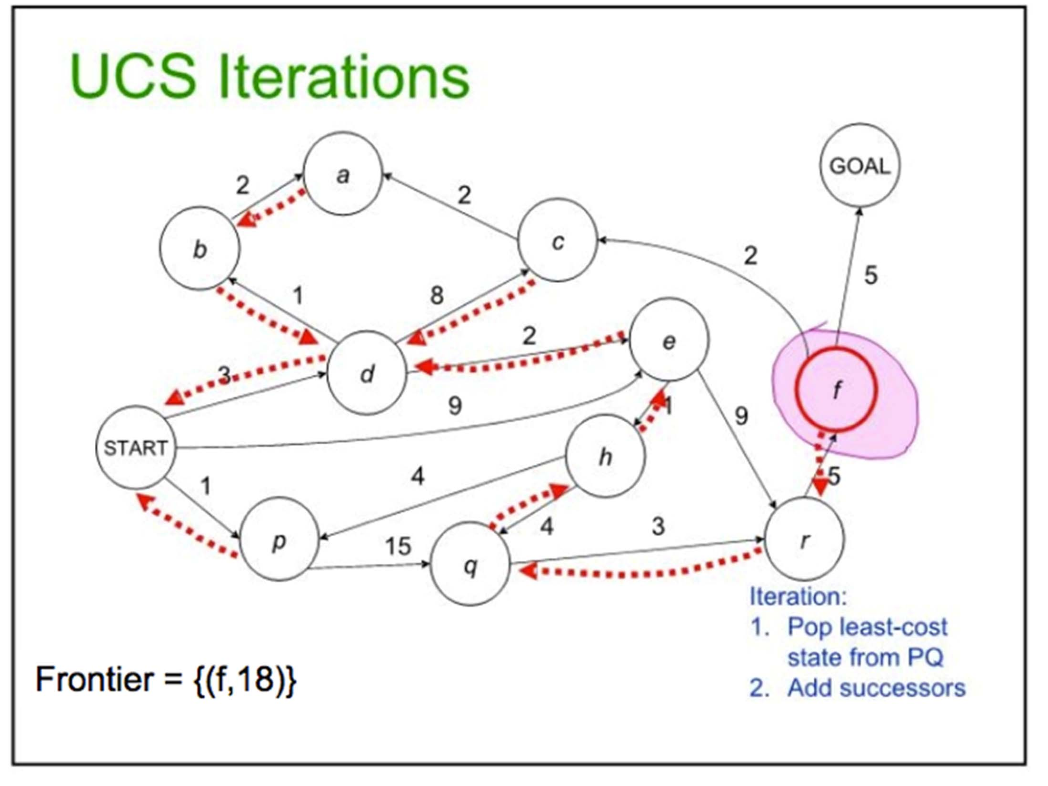
34

Slide 35
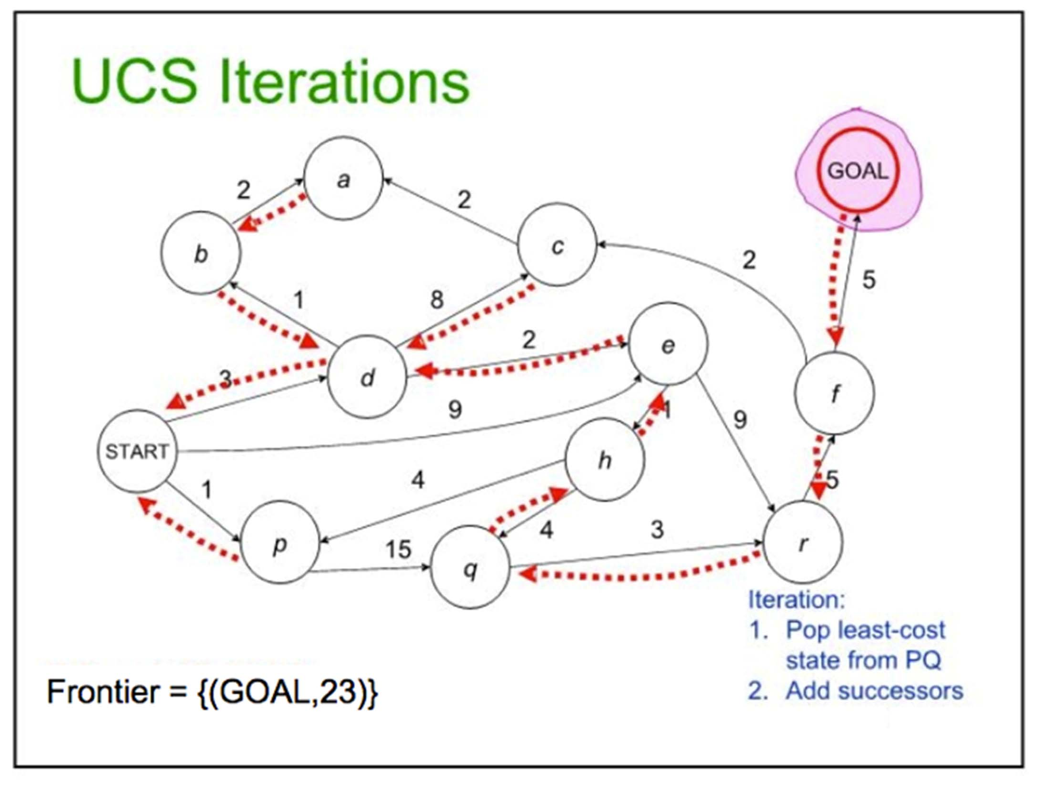
35

Slide 36
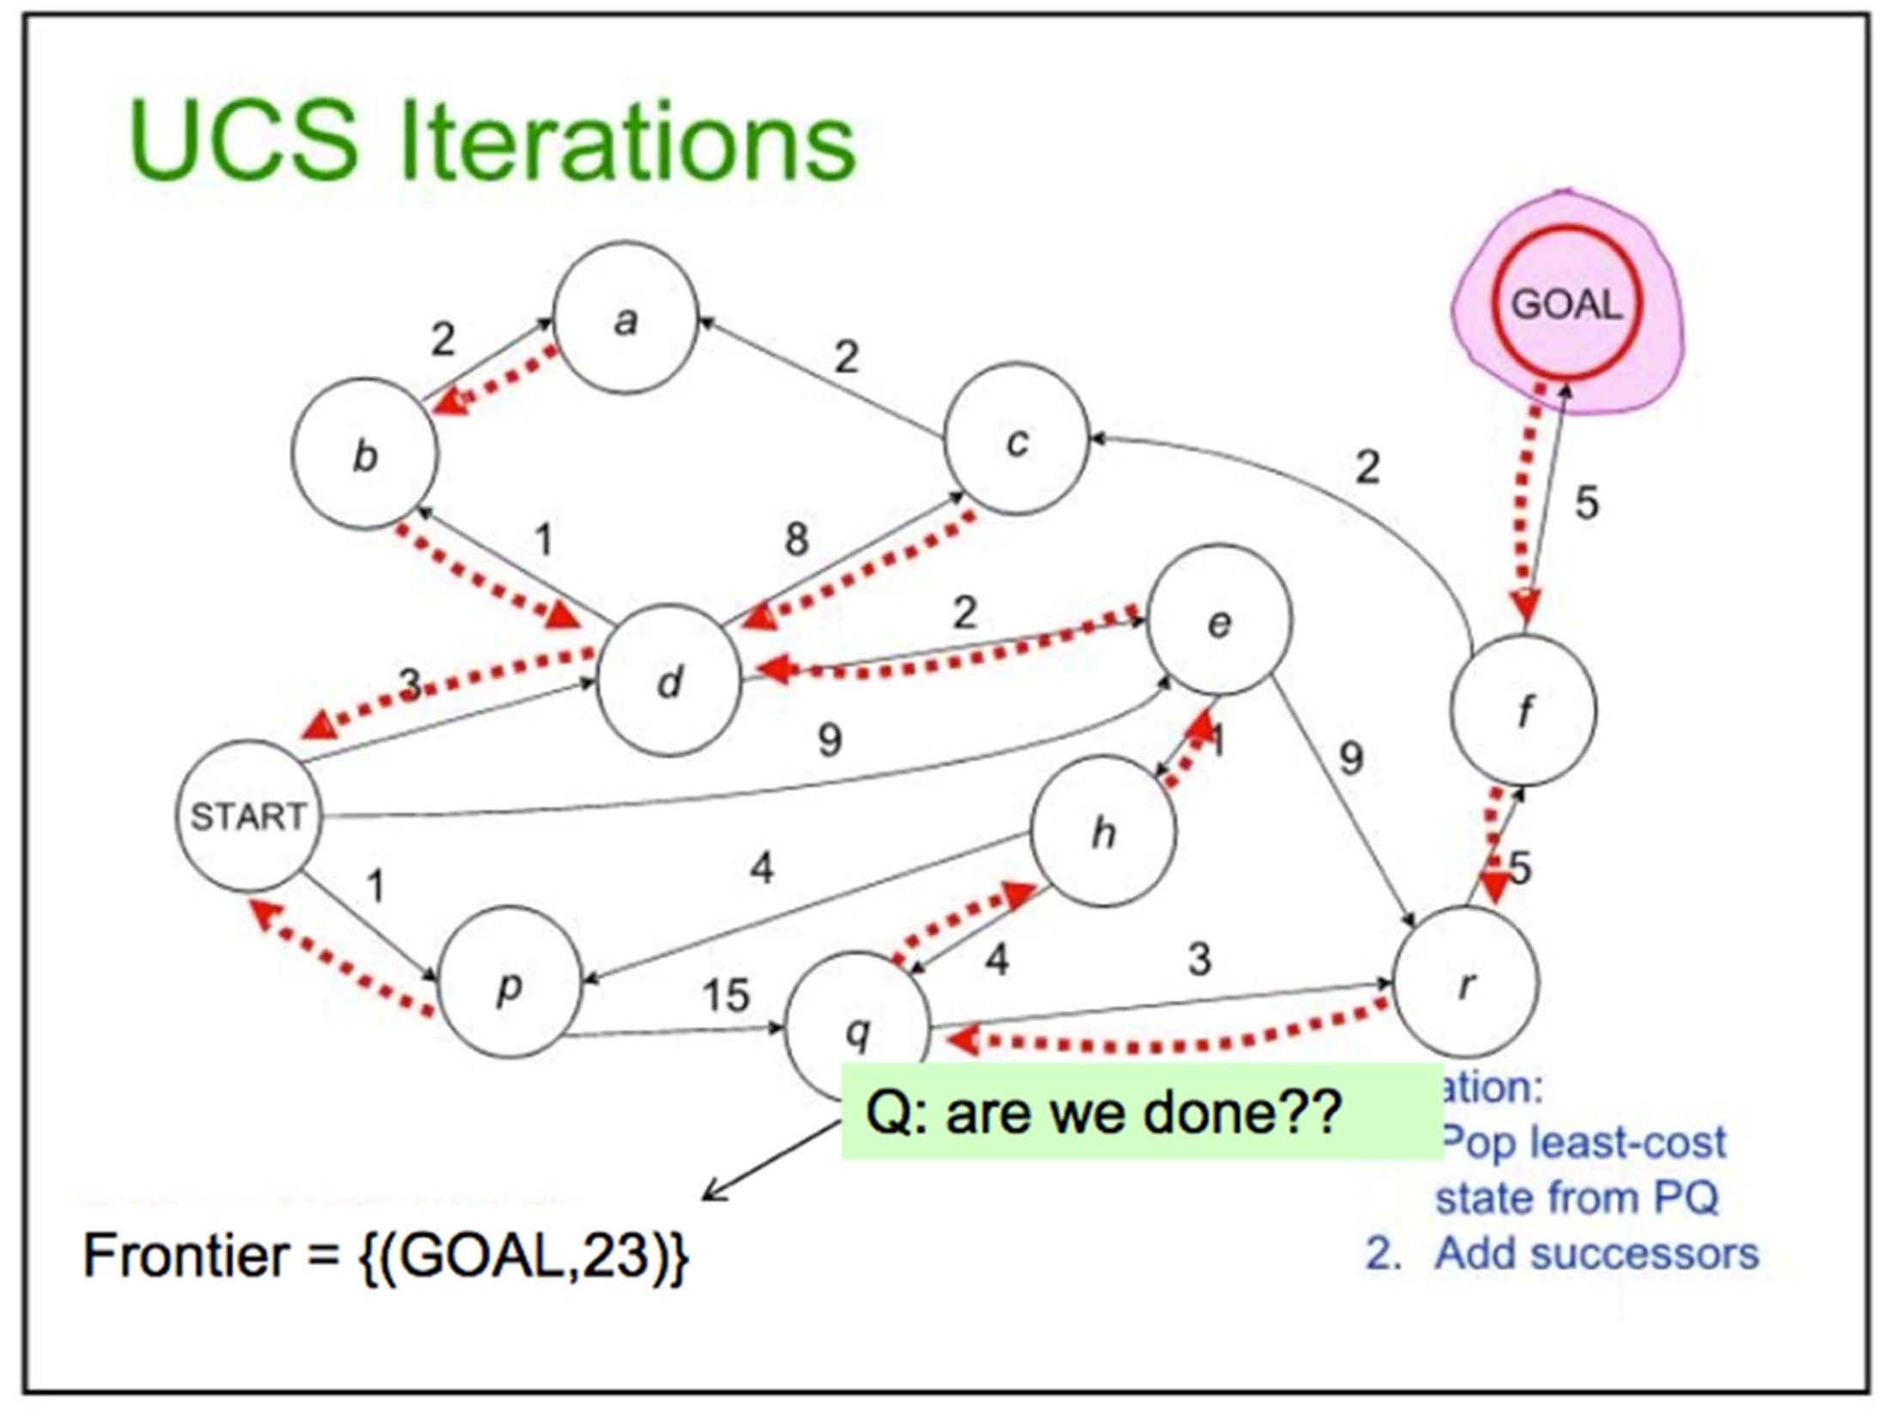
36

Slide 37
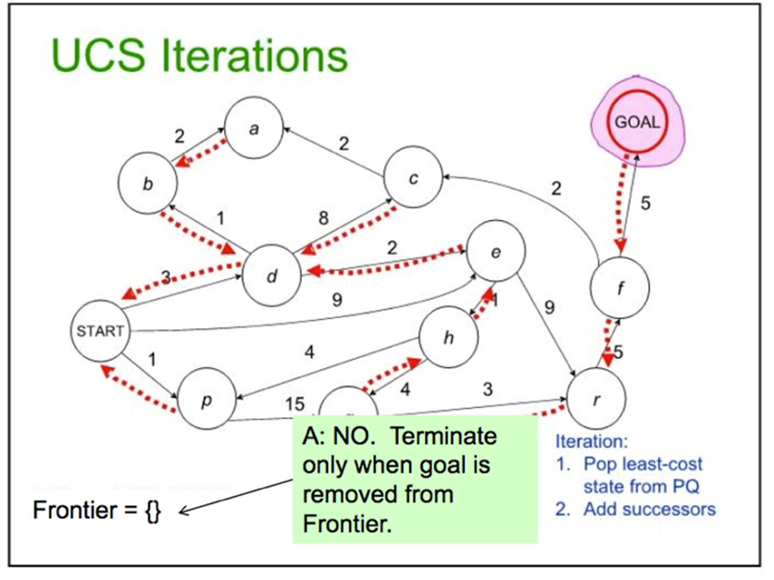
37

Slide 38
4. Uniform-cost Search Algorithm:
Uniform-cost search is a searching algorithm used for traversing a weighted tree or graph.
The primary goal of the uniform-cost search is to find a path to the goal node which has the lowest cumulative cost.
A uniform-cost search algorithm is implemented by the priority queue. It gives maximum priority to the lowest cumulative cost.
Advantages:
Uniform cost search is optimal because at every state the path with the least cost is chosen.
Disadvantages:
It does not care about the number of steps involve in searching and only concerned about path cost. Due to which this algorithm may be stuck in an infinite loop.

Slide 39
Iterative Deepening Search

Slide 40
Iterative Deepening Search

Slide 41
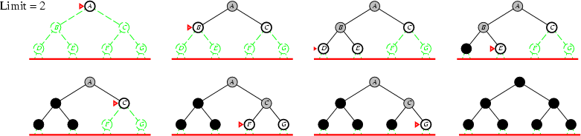
Iterative Deepening Search

Slide 42
Iterative Deepening Search

Slide 43
Informed Search Algorithms
Informed search algorithm contains an array of knowledge such as how far we are from the goal, path cost, how to reach to goal node, etc.
This knowledge help agents to explore less to the search space and find more efficiently the goal node.
The informed search algorithm is more useful for large search space.
Informed search algorithm uses the idea of heuristic, so it is also called Heuristic search.

Slide 44
Heuristics function
Heuristic is a function which is used in Informed Search, and it finds the most promising path.
The heuristic method, however, might not always give the best solution, but it guaranteed to find a good solution in reasonable time.
Heuristic function is represented by h(n), and it calculates the cost of an optimal path between the pair of states.
The value of the heuristic function is always positive.
Admissibility of the heuristic function is given as:
h(n) <= h*(n)
Here h(n) is heuristic cost,
and h*(n) is the estimated cost.

Slide 45
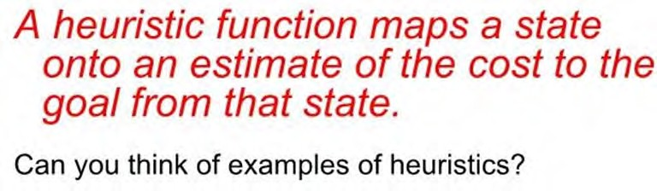
Heuristic functions
We can encode each notion of the “ merit” of a state into a heuristic function, h(n).
Heuristics are sensitive to the problem domain. Heuristic for planning a path through a maze?
For solving a Rubick’s cube?

Slide 46
Heuristic Search
If h(n₁) < h(n₂) this means that we guess that it is cheaper to get to the goal from n₁ than from n₂.
We require that
h(n) = 0 for every node n whose terminal state satisfies the goal.
Zero cost of achieving the goal from node that already satisfies the goal.

Slide 47
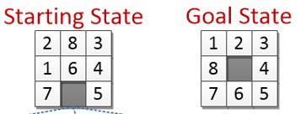
Examples of Heuristics
8 Puzzle Problem: The task is to convert the current state into goal state by sliding digits into the blank space
Heuristic Functions:
Count the no of tiles out of place in a state when it is compared with the
goal state. h(Initial State) = 4 and h(Goal State) = 0
2. Count the no of tiles in a correct place in a state when it is compared with
the goal state. h(Initial State) = 4 and h(Goal State) = 8
Calculate the Manhattan distance for a state, i.e. sum of the distances of
the tiles from their goal position. h(Initial State) = 5 and h(Goal State) = 0

Slide 48
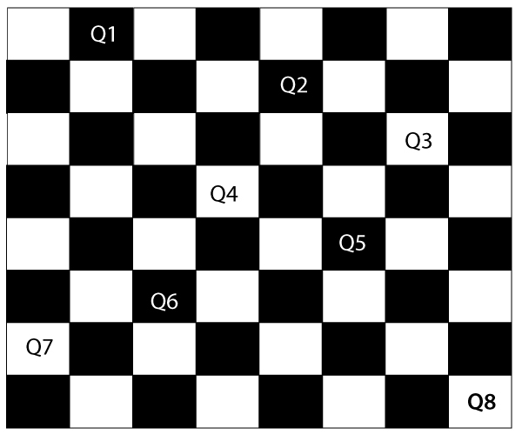
Examples of Heuristics
8-Queens Problem: The aim of this problem is to place eight queens on a chessboard in an order where no queen may attack another.
A queen can attack other queens either diagonally or in same row and column.
Heuristic Function: Count the number of pairs of queens attacking each other, either directly or indirectly.
It means h(goal state) = 0
Here, Pairs attacking are: (Q7,Q4), (Q1,Q5) and (Q4,Q8).
There for h(n) = 3

Slide 49
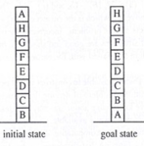
Examples of Heuristics
Block World Problem: In this problem the gaming blocks are need to be arranged as per the goal state
Heuristic function 1: Add 1 point for every block i.e. resting on the thing it is supposed to be resting on. Subtract 1 point for every block that is resting on wrong thing. h(IS) = 4 and h(GS) = 8
Heuristic function 2: For each block that has correct support structure, add 1 point for every block in the support structure. For each block that has incorrect support structure, subtract 1 point for every block in the support structure. h(IS) = -28 and h(GS) = +28

Slide 50
Pure Heuristic Search:
Pure heuristic search expands nodes based on their heuristic value, h(n).
It maintains two lists, OPEN and CLOSED list.
In the CLOSED list, it places those nodes which have already expanded and in the OPEN list, it places nodes which have yet not been expanded (fringe).
On each iteration, each node, n with the lowest heuristic value is expanded and generates all its successors and n is placed to the closed list.
The algorithm continues unit a goal state is found.

Slide 51
Hill Climbing Algorithm
Hill climbing algorithm is a local search algorithm which continuously moves in the direction of increasing elevation/value to find the peak of the mountain or best solution to the problem.
It terminates when it reaches a peak value where no neighbour has a higher value.
It is also called greedy local search as it only looks to its good immediate neighbour state and not beyond that.
State-space Diagram for Hill Climbing:
The state-space landscape is a graphical representation of the hill-climbing algorithm
State-space on the x-axis and objective or cost function on Y-axis.
regions of state space on next slide….

Slide 52
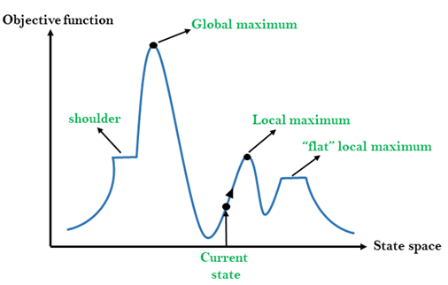
Different regions:
Current state: It is a state in a landscape diagram where an agent is currently present.
Flat local maximum: It is a flat space in the landscape where all the neighbor states of current states have the same value. It is a plateau.
Shoulder: It is a plateau region which has an uphill edge.
Local Maximum: Local maximum is a state which is better than its neighbor states, but there is also another state which is higher than it.
Global Maximum: Global maximum is the best possible state of state space landscape. It has the highest value of objective function.

Slide 53
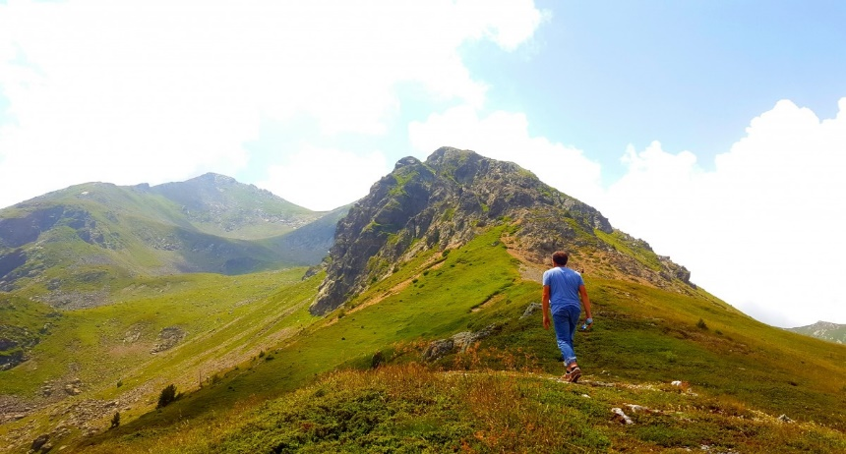
Types of Hill Climbing Algorithm:
Simple hill Climbing
Steepest-Ascent hill-climbing
Stochastic hill Climbing
1. Simple Hill Climbing:
It only evaluates the neighbour node state at a time and selects the first one which optimizes current cost and set it as a current state.
It only checks it's one successor state, and if it finds better than the current state, then move else be in the same state.
Features:
Less time consuming
Less optimal solution and the solution is not guaranteed

Slide 54
Algorithm:
Step 1: Evaluate the initial state, if it is goal state then return success and Stop.
Step 2: Loop Until a solution is found or there is no new operator left to apply.
Step 3: Select and apply an operator to the current state.
Step 4: Check new state:
If it is goal state, then return success and quit.
Else if it is better than the current state then assign new state as a current state.
Else if not better than the current state, then return to step2.
Step 5: Exit.

Slide 55

Hill climbing:
2. Steepest-Ascent hill climbing:
The steepest-Ascent algorithm is a variation of simple hill climbing algorithm.
This algorithm examines all the successor nodes of the current state and selects one neighbor node which is closest to the goal state.
This algorithm consumes more time as it searches for multiple neighbors

Slide 56
Algorithm for Steepest-Ascent HC:
Step 1: Evaluate the initial state, if it is goal state then return
success and stop, else make current state as initial state.
Step 2: Loop until a solution is found or the current state does
not change.
Let SUCC be a state such that any successor of the current state will be better than it.
For each operator that applies to the current state:
Apply the new operator and generate a new state.
Evaluate the new state.
If it is goal state, then return success and quit, else compare it to the SUCC.
If it is better than SUCC, then set new state as SUCC.
If the SUCC is better than the current state, then set current state to SUCC.
Step 3: Exit.

Slide 57
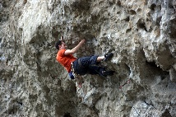
Hill climbing:
3. Stochastic hill climbing:
Stochastic hill climbing does not examine for all its neighbor before moving. Rather, this search algorithm selects one neighbor node at random and decides whether to choose it as a current state or examine another state.

Slide 58
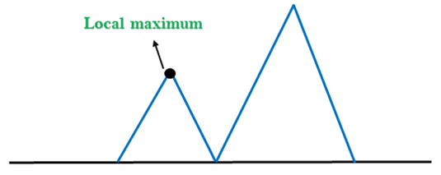
Hill Climbing:
Problems in Hill Climbing:
1. Local Maximum:
A local maximum is a peak state in the landscape which is better than each of its neighboring states, but there is another state also present which is higher than the local maximum.
Solution:
Backtracking technique can be a solution of the local maximum in state space
landscape.

Slide 59
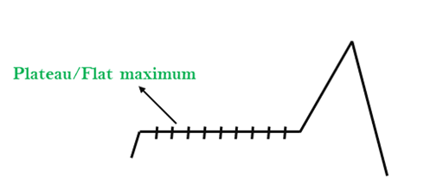
Hill Climbing:
2. Plateau:
A plateau is the flat area of the search space in which all the neighbor states of the current state contains the same value.
Solution: The solution for the plateau is to take big steps or very little steps while searching.

Slide 60
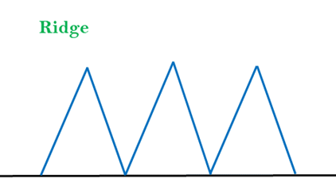
Hill Climbing:
3. Ridges:
A ridge is a special form of the local maximum. It has an area which is higher than its surrounding areas, but itself has a slope, and cannot be reached in a single move.
Solution: With the use of bidirectional search, or by moving in different directions, we can improve this problem.

Slide 61
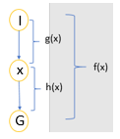
Best-first Search Algorithm:
This algorithm always selects the path which appears best at that moment.
It uses the heuristic function and search.
In the best first search algorithm, we expand the node which is closest to the goal node and the closest cost is estimated by heuristic function, i.e.
f(n)= h(n).
where, n is a intermediate node and h(n)= estimated cost from node n to the goal.
The greedy Best first algorithm is implemented
by the priority queue.
I | Initial state
G | Goal state
X | Intermediate state
g(x) | Distance of node X from node I
h(x) | Distance of node G from node X
f(x) | Complete distance from node I to node G through node X

Slide 62
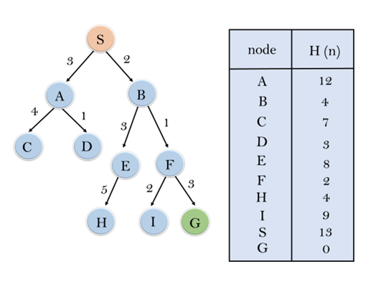
Example on Greedy B-FS
In the following search problem, we will traverse using greedy Best-First Search.
At each iteration, each node is expanded using evaluation function f(n)=h(n), which is given in the below table.

Slide 63
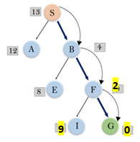
Search…
In this search example, we are using two lists which are OPEN and CLOSED Lists.
Hence the final solution path will be: S → B → F → G
Path cost = 2+1+3 = 6
Node | S | A | B | C | D | E | F | H | I | G
h(n) | 13 | 12 | 4 | 7 | 3 | 8 | 2 | 4 | 9 | 0
Initialization | Expand the nodes of S and put in the CLOSED list
Iteration 1 | Open [A, B], Closed [S]
Iteration 2 | Open [A], Closed [S, B]
Iteration 3 | Open [E, F, A], Closed [S, B] Open [E, A], Closed [S, B, F]
Iteration 4 | Open [I, G, E, A], Closed [S, B, F] Open [I, E, A], Closed [S, B, F, G]

Slide 64
Best first search algorithm:
Step 1: Place the starting node into the OPEN list.
Step 2: If the OPEN list is empty, Stop and return failure otherwise go to
Step 3
Step 3: Remove the node n, from the OPEN list which has the lowest value
of h(n), and places it in the CLOSED list.
Step 4: Expand the node n, and generate the successors of node n.
Step 5: Check each successor of node n, and find whether any node is a
goal node or not. If any successor node is goal node, then return
success and terminate the search, else proceed to Step 6.
Step 6: For each successor node, algorithm checks for evaluation function
f(n), and then check if the node has been in either OPEN or
CLOSED list. If the node has not been in both list, then add it to
the OPEN list.
Step 7: Return to Step 2.

Slide 65
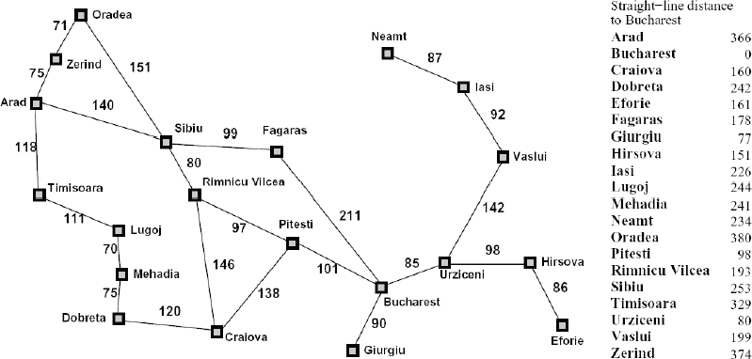
Euclidean distance as h(s)
Say we want to plan a path from Arad to Bucharest, and we know the straight line distance from each city to our goal. This lets us plan our trip by picking cities at each time point that minimize the distance to our goal (or maximize our heuristic).

Slide 66
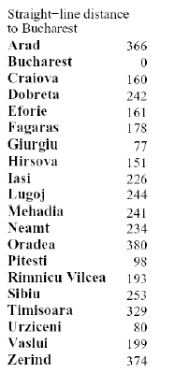
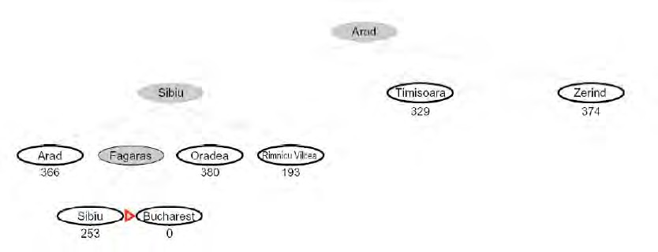
Best first (greedy) search
If we only use h(n) to guide our search, the search strategy is called Greedy or Best First Search
How can it possibly go wrong??

Slide 67
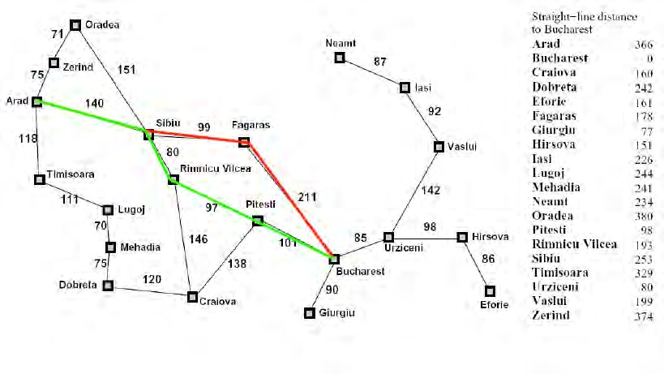
Best first (greedy) search
In red is the path we selected. In green is the shortest path between Arad and Bucharest. What happened?

Slide 68
Best First Search
Advantages:
Best first search can switch between BFS and DFS by gaining the advantages of both the algorithms.
This algorithm is more efficient than BFS and DFS algorithms.
Disadvantages:
It can behave as an unguided depth-first search in the worst case scenario.
It can get stuck in a loop as DFS.
This algorithm is not optimal.

Slide 69

A* Search Algorithm:
A* search is the most commonly known form of best-first search.
It uses heuristic function h(n), and cost to reach the node n from the start state g(n).
A* algorithm is similar to UCS except that it uses g(n)+h(n) instead of g(n).
In A* search algorithm, we use search heuristic as well as the cost to reach the node. Hence we can combine both costs , this sum is called as a fitness number.
At each point in the search space, only those node is expanded which have the lowest value of f(n) and the algorithm terminates when the goal node is found.

Slide 70

Example on A* search:
In this example, the heuristic value of all states is given in the below table so we will calculate the f(n) of each state using the formula f(n)= g(n) + h(n), where g(n) is the cost to reach any node from start state.
Here again we will use OPEN and CLOSED list.

Slide 71

Solution:
State | S | A | B | C | D | G
h(n) | 5 | 3 | 4 | 2 | 6 | 0
Initialization: | {(S, 5)}
Iteration1: | {(S → A, 4), (S → G, 10)}
Iteration2: | {(S → A → C, 4), (S → A → B, 7), (S → G, 10)}
Iteration3: | {(S → A → C → G, 6), (S → A → C → D, 11), (S → A → B, 7), (S → G, 10)}
Iteration4: | Will give the final result, as S → A → C → G It provides the optimal path with cost 6.

Slide 72
Algorithm of A* search:
Step 1: Place the starting node in the OPEN list.
Step 2: Check if the OPEN list is empty or not, if the list is empty then return failure and stop, Otherwise Go to step 3.
Step 3: Select the node from the OPEN list which has the smallest value of evaluation function (g+h), if node n is goal node then return success and stop, otherwise Go to step 4.
Step 4: Expand node n and generate all of its successors, and put n into the CLOSED list. For each successor n', check whether n' is already in the OPEN or CLOSED list, if not then compute evaluation function for n' and place into OPEN list.
Step 5: Else if node n' is already in OPEN and CLOSED, then it should be attached to the back pointer which reflects the lowest g(n') value.
Step 6: Return to Step 2.

Slide 73
A* search:
Advantages:
A* search algorithm is the best algorithm than other search algorithms.
A* search algorithm is optimal and complete.
This algorithm can solve very complex problems.
Disadvantages:
It does not always produce the shortest path as it mostly based on heuristics and approximation.
A* search algorithm has some complexity issues.
The main drawback of A* is memory requirement as it keeps all generated nodes in the memory.

Slide 74

8 puzzle using A*
Level 0
g = 0
Level 1
g = 1
Level 2
g = 2
h(n): count the no of tiles not in place.
Level 3
g = 3

Slide 75
Game Tree Search
Min-Max search
Alpha-Beta pruning search
Monte Carlo Tree Search
These searching techniques are used for solving problems were two or more than two players are involved.

Slide 76
Monte Carlo Tree Search in Reinforcement Learning
Avinash Shrivas

Slide 77

Overview
Monte Carlo tree search (MCTS) algorithm consists of four phases:
Selection
Expansion
Rollout/Simulation
Backpropagation

Slide 78
MCTS
1. Selection
Algorithm starts at root node R, then moves down the tree by selecting optimal child node until a leaf node L(no known children so far) is reached.
2. Expansion
If L is a not a terminal node (it does not terminate the game) then create one or more child nodes according to available actions at the current state (node), then and select the first of these new nodes M.

Slide 79
MCTS
3. Simulation
Run a simulated rollout from M until a terminal state is found. The terminal state contains a result (value) that will be returned to upwards in the is backpropagation phase.
NB. The states or nodes in which the rollout passes through are not considered visited.
4. Backpropagation
After the simulation phase, a result is returned. All nodes from M up to R will be updated by adding the result to their value and increase the count of visits at each node.

Slide 80

MCTS
Selection & Expansion:
The algorithm starts at a node or state that is considered the root, then selects a child node to move to.
The selection is based on the Upper Confidence Bounds (UCB1) formula:
Where, vᵢ is the value at state Si,
nᵢ is number of visits at state Si,
N is the total number of visits of the nodes at the same level (or in other words the number of visits at the parent of Si),
C is a constant used for fine tuning.
After computing the UCB1 for every child of the current node, the one with the highest value is chosen.

Slide 81

MCTS
If the selected node is new, meaning it is not visited yet, Rollout is called to find a terminal state with value. Otherwise, if it is visited, then create child nodes for all actions available at the current node, the move to the first of the child nodes and begin a Rollout.

Slide 82

MCTS
Rollout or Simulation
The Rollout or Simulation is the phase in which random actions are taken, retrieve the landing state then take another random action in order to land in a new state.
This process is iterated until a terminal state is reached, at that point the value of the terminal stated is returned.

Slide 83

MCTS
Backpropagation
the back propagation gets the value of the Rollout and updates the nodes from the start of the Rollout till the root node.
The update consists of adding the Rollout result to the current value of each node, and to increase by one the count of visits at each of these nodes.

Slide 84

MCTS
Example:
The following is an example that unrolls all the different phases of the MCTS algorithm.
Let’s start with root node S0. We assume that it has been visited before, so it is not new. So we need to expand it. We assume that there are 2 actions (A1, A2) at this state. We expand the tree by adding two states S1 and S2 resulting from the actions A1, A2. Since the UCB1 for both S1 and S2 is infinity (since N1=0 and N2=0) we choose to go at first with A1.

Slide 85

MCTS
Now S1 is new because it has not been visited yet (N1 = 0).
The algorithm says that in this case we should rollout until we reach a terminal state.
Let’s assume that we did just that and found a terminal node with value 20.
We propagate this value from S1 upwards to S0 (text in blue). So S1 and S0 will have both values equal 20 and the number of visits equals 1.

Slide 86

MCTS
Now in the second iteration, UCB1(S1) = 20 and UCB1(S2) = infinity, so we take action A2. Also we notice that S2 is new (N2=0) so we rollout until we find a terminal state.
We assume that the terminal state has a value 10.
We backpropagate it from S2 up to S0 (text in blue).
At the end we get S2 (V2=10, N2=1) and S0(V0 = 30, N0=2)

Slide 87

MCTS
In the third iteration, UCB1(S1) = 20 and UCB1(S2) = 10, so we choose to go to S1.
Since now it is not new anymore (N1 > 0) we expand it by adding the available actions and their landing states.
We suppose that there are 2 actions A3, A4 with the respective states S3 and S4.
Since both S3 and S4 have UCB1 infinity we choose S3 by following actin A3.
S3 is new so we rollout until we find terminal state with value 15. We backpropagate this value to node S3, S1, S0. The updated values can be seen in the blue text.

Slide 88
MCTS
Advantages:
Aheuristic: MCTS does not require any knowledge about the given domain.
Apart from the game rules and conditions it does not need to know any strategy or tactics, which makes it reusable for other games with small modifications.
Asymmetric: MCTS visits more interesting nodes more often, and focusses its search time in more relevant parts of the tree.
Anytime: It is possible to stop the algorithm at any time to return the current best estimate.
Elegant:
The algorithm is not complex and is easy to implement.

Slide 89
MCTS
Disadvantages
Playing Strength:
MCTS, in its basic form, can fail to find reasonable moves for games even of medium complexity within a reasonable amount of time.
Speed:
MCTS search can take many iterations to converge to a good solution, which can be an issue for more general applications that are difficult to optimise.

Slide 90
MCTS
Improvements
Domain Knowledge:
Domain knowledge specific to the current game can be help filter out unlikely moves or to produce rollouts that are more similar to the ones that would occur between human opponents.
This has the benefit of rollout results that will be more realistic than random simulations and that nodes will require fewer iterations to yield realistic reward values.

Slide 91
MCTS
Domain Independent:
Domain independent enhancements do not tie the implementation to a particular domain, maintaining generality, and are hence the focus of most current work in the area.

